Slide 1

High-Precision Prediction for a DIS Event Shape
June-Haak Ee
LANL
in collaboration with
Christopher Lee (LANL), Daekyoung Kang (Fudan U. & Korea U.),
Iain Stewart (MIT)
Korea EIC theory meeting
Mar. 21, 2025

Slide 2
Outline
Background and Motivation:
Why and how we study $τ_{1}^{b}$
Theoretical Formalism
Results and comparison with HERA data
Summary

Slide 3
Background and Motivations:
Why do we study event shape $τ_{1}^{b}$?

Slide 4
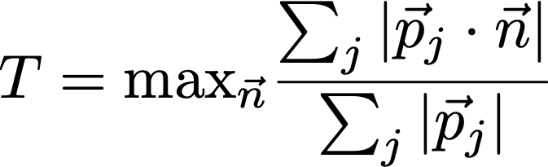
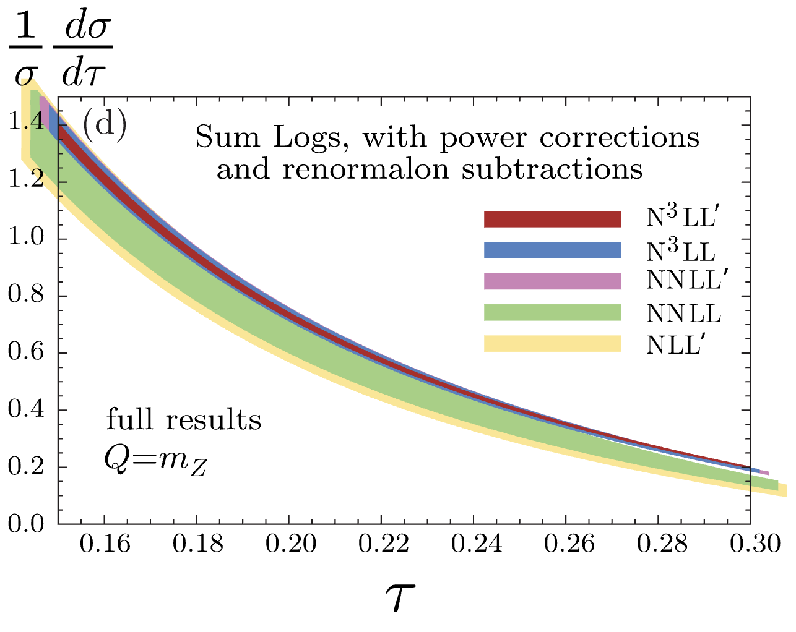
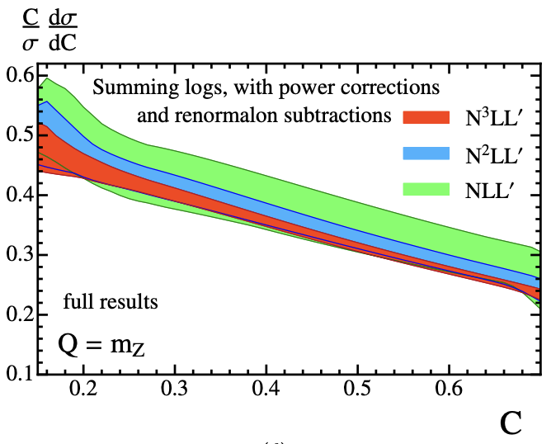
Hadronic Event shapes
Event shape: Captures global geometry of events
(e.g. $e^{+}e^{-}$ thrust)
$$τ=1-T$$
where
(Sum over all final states; inclusive)
$$\overset{⃗}{n}$$
$$e^{+}$$
$$e^{-}$$
$$e^{+}$$
$$e^{-}$$
$$T∼1$$
$$T∼1/2$$
$$τ∼0$$
$$τ∼τ_{\text{max}}∼1/2$$
For $e^{+}e^{-}$ collisions, ${\text{N}}^{3}\text{LL}′$ resummation including nonperturbative corrections has been achieved:
Thrust: Abbate et al.,arXiv:1006.3080
C parameter: Hoang et al.,arXiv:1411.6633

Slide 5
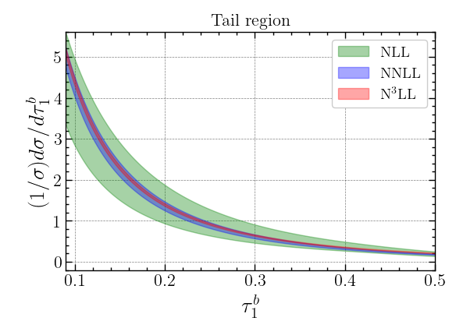
Background and Motivation
Objective: Accurate description of cross sections in DIS ($ep$) for jet production.
Observable: DIS event shape $τ_{1}^{b}$, a special form of $N$-jettiness.
Method: SCET-1 factorization theorem with N³LL resummation, combined with
two-loop fixed-order QCD corrections
Result: Cross section expressed as a distribution in $τ_{1}^{b}$
This framework offers one of the most precise approaches to determining $α_{s}$ and universal nonperturbative constant $Ω_{1}$ in DIS.

Slide 6
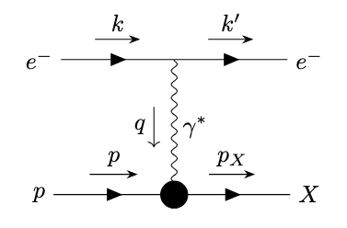
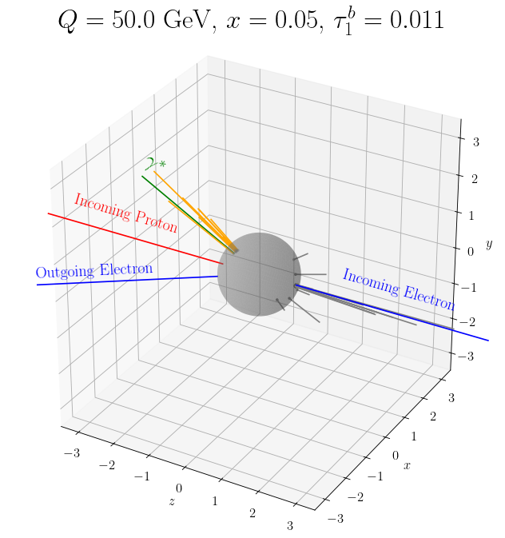
DIS kinematics
$$q=k-k^{′}$$
$$p$$
$$k^{′}$$
$$k$$
$$Q^{2}=-q^{2}$$
$$x=\frac{Q^{2}}{2p⋅q}$$
$$y=\frac{p⋅q}{p⋅k}$$

Slide 7
DIS kinematics
The # of DOF for the usual DIS is 3:
  We have 4 external momenta $→$ 16 DOF
  On-shell conditions $→$ Remove 4 DOF
  Energy conservations at each vertex
  $→$ Remove $4×2=8$ DOF
  Remaining # of DOF: 4
  Usually, we describe DIS using $s,Q^{2},x,y$
  But they are redundant: $Q^{2}=sxy$.
The reason for describing DIS with 3 DOF instead of 4 is due to its inherent azimuthal symmetry:
$$Q^{2}=-q^{2}$$
$$x=\frac{Q^{2}}{2p⋅q}$$
$$y=\frac{p⋅q}{p⋅k}$$
In Lab frame, $p=(p,0,0,p)$ and $k=(k,0,0,k)$, and we can set $q=(q_{0},q_{T}sinϕ,q_{T}cosϕ,q_{3})$ with $q_{0}^{2}=q_{T}^{2}+q_{3}^{2}-Q^{2}$,
and $Q^{2},x,y$ are independent of $ϕ$.

Slide 8
Definition of $τ_{1}^{b}$
$τ_{1}^{b}$ is defined using the momenta of the final states, $p_{i}$, projected onto one of the reference vectors $q_{B}$ or $q_{J}$.
$$τ_{1}^{b}=\frac{2}{Q^{2}}\underset{i∈X}{∑}\text{min}\left\{q_{B}^{b}⋅p_{i},q_{J}^{b}⋅p_{i}\right\}$$
$$H_{B}$$
$$H_{J}$$
The minimization procedure separates the final states into two sets, $H_{B}$ and $H_{J}$.
The reference vectors are determined by the incoming proton momentum and the incoming and outgoing lepton momenta ($x,P,q=k-k^{′}$):
$$q_{B}^{μ}=xP^{μ}$$
$$q_{J}^{μ}=q^{μ}+xP^{μ}$$
Once $p_{i}$ is measured, $τ_{1}^{b}$ can be computed straightforwardly.

Slide 9
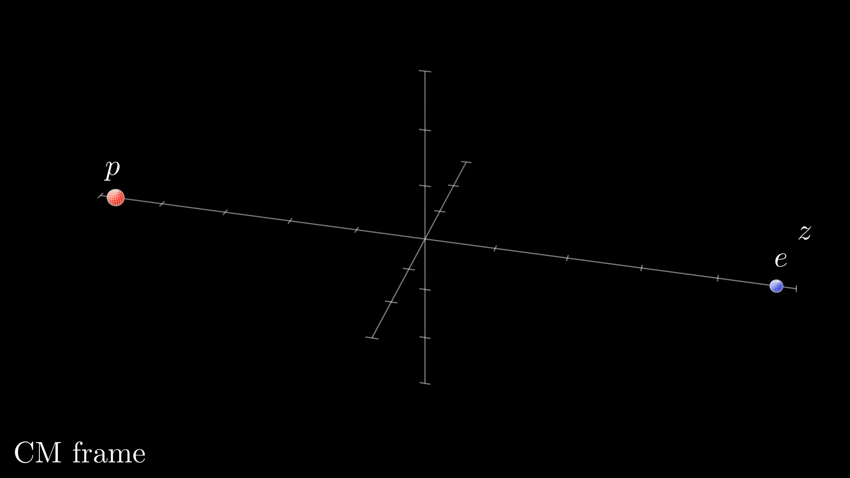

Slide 11
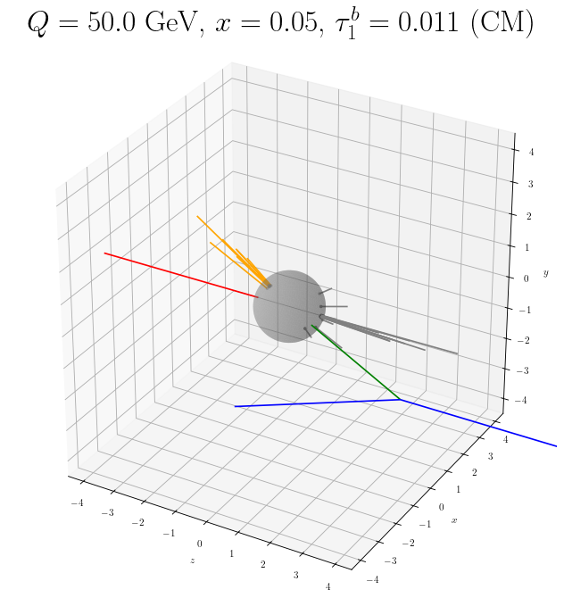
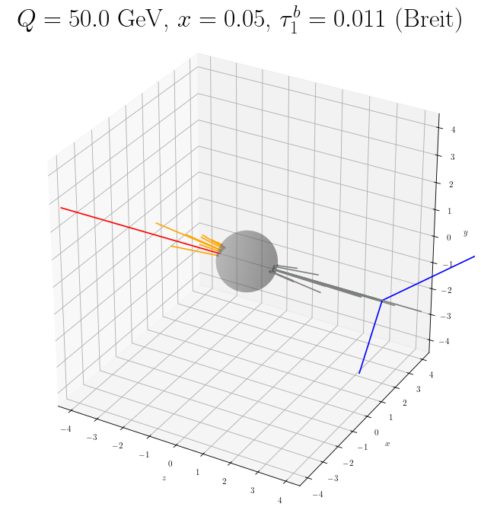
$τ_{1}^{b}$ in Breit frame
$τ_{1}^{b}$ has the most intuitive interpretation in Breit frame, where the off-shell photon and proton are aligned along $z$ axis.
$$p$$
Breit frame
$$p$$
$$γ^{*}$$
$$e$$
$$γ^{*}$$
$$e$$
$$q_{B}^{μ}=xP^{μ}\overset{\text{Breit}}{=}\frac{Q}{2}n_{z}$$
$$q_{J}^{μ}=q^{μ}+xP^{μ}\overset{\text{Breit}}{=}\frac{Q}{2}{\overline{n}}_{z}$$
$$n_{z}=(1,0,0,1)$$
$${\overline{n}}_{z}=(1,0,0,-1)$$
In this frame,$τ_{1}^{b}$ separates the final-state particles based on the $z$ component of their momenta $p_{i}$.
$$τ_{1}^{b}\overset{\text{Breit}}{=}\frac{1}{Q}\underset{i∈X}{∑}\text{min}\left\{n_{z}⋅p_{i},{\overline{n}}_{z}⋅p_{i}\right\}$$
The sign of $z$ component of $p_{i}$ determines $p_{i}∈H_{B/J}$

Slide 12
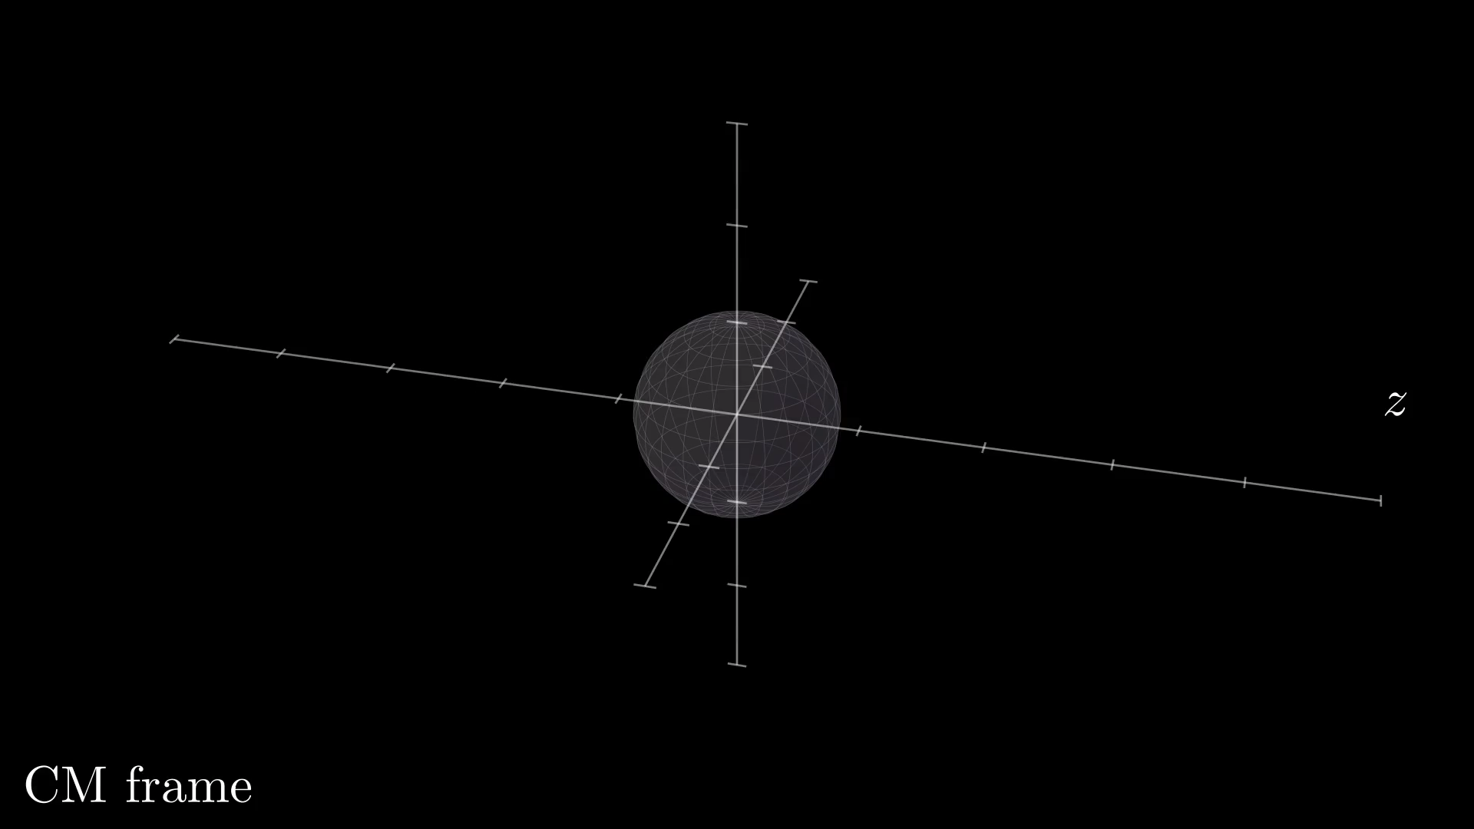
$$τ_{1}^{b}=0.011$$

Slide 13
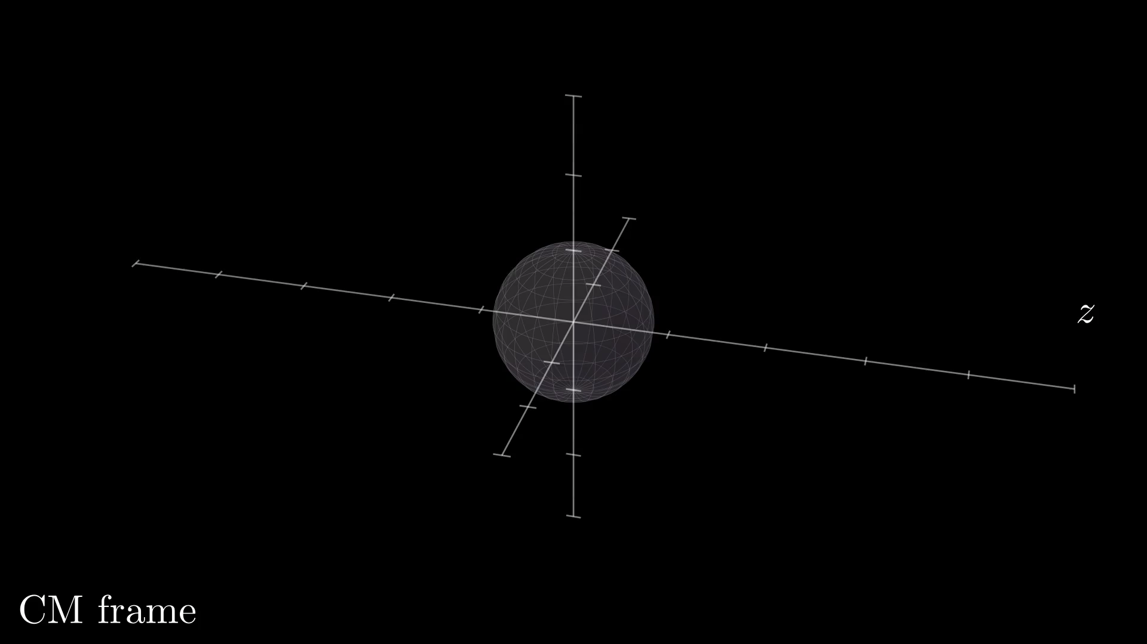
$$τ_{1}^{b}=0.204$$

Slide 14
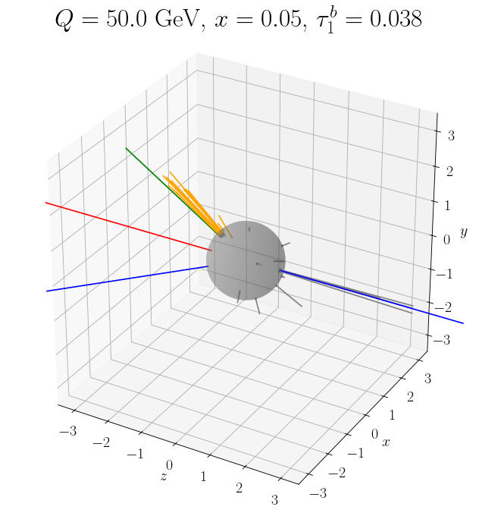
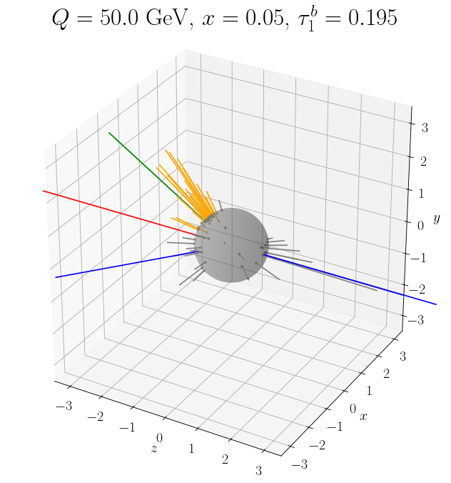
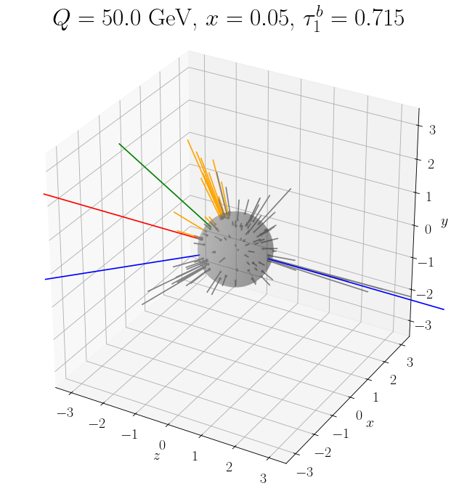
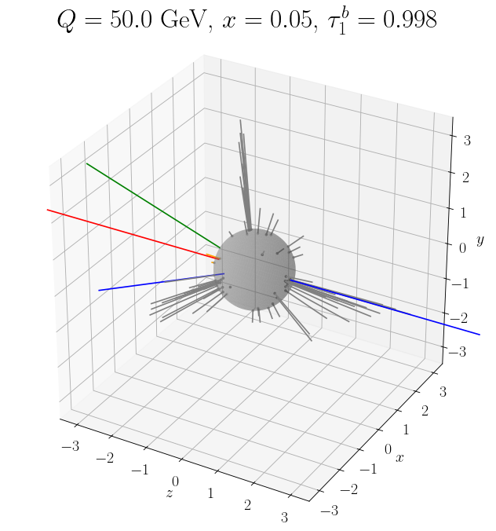
Event shape $τ_{1}^{b}$

Slide 15
Advantages of $τ_{1}^{b}$
$τ_{1}^{b}$ agrees with the classical DIS thrust $τ_{Q}$:
Energy-momentum conservation
classical DIS thrust variable $τ_{Q}$
arXiv:hep-ph/9912488
Antonelli, Dasgupta, Salam
$$τ_{1}^{b}\overset{\text{Breit}}{=}1-\frac{2}{Q}\underset{i∈H_{J}}{∑}(p_{i})_{z}=τ_{Q}$$
Reduces contamination from remnant fragmentation, making it highly suitable for experimental studies.
Can be determined by measuring only the momenta in $H_{J}$ (orange)
Lorentz invariant, and global observable, eliminating non-global logarithms (NGLs).
$→$ Allows for precise theoretical predictions

Slide 16
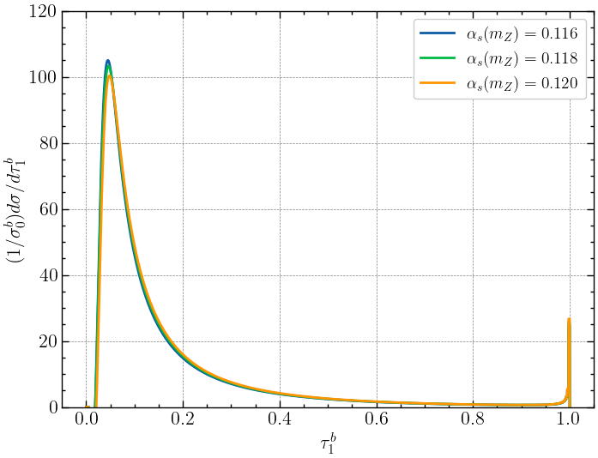
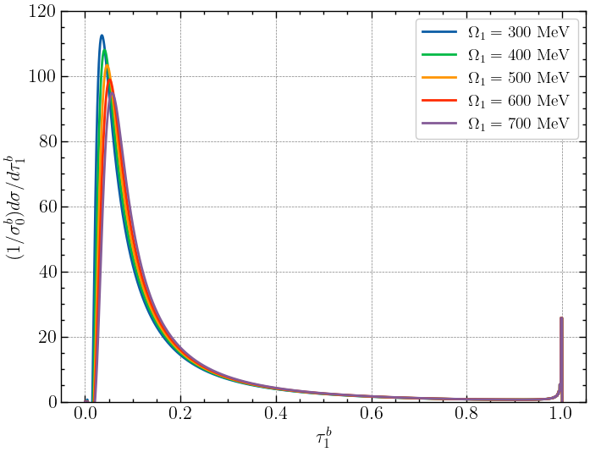
Event shapes and $α_{s}$
Our ultimate goal is to determine the fundamental constants of QCD, $α_{s}(m_{Z})$ and universal nonperturbative constant $Ω_{1}$ (1st moment of the shape function):
The shape of the $τ_{1}^{b}$ distributions depend on the values of $α_{s}(m_{Z})$ and $Ω_{1}$:
$$Δα_{s}(m_{Z})$$
$$ΔΩ_{1}$$

Slide 17
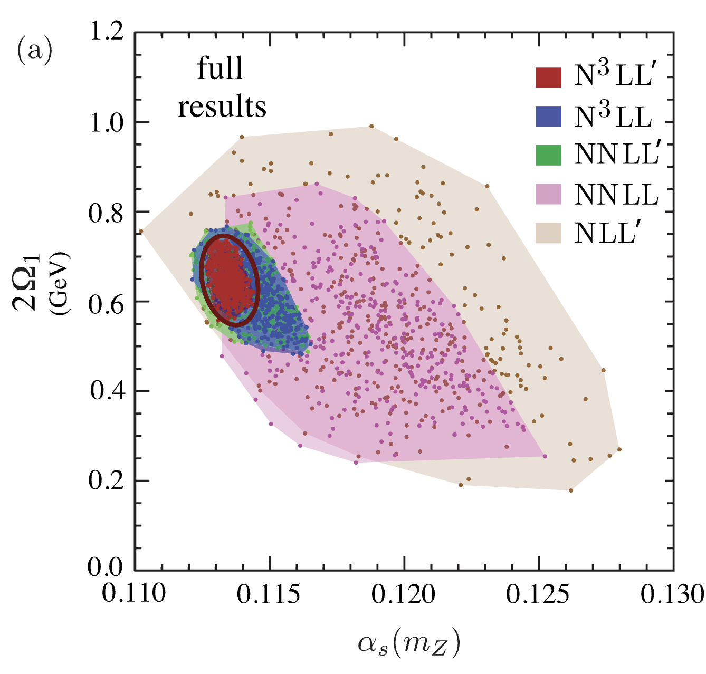
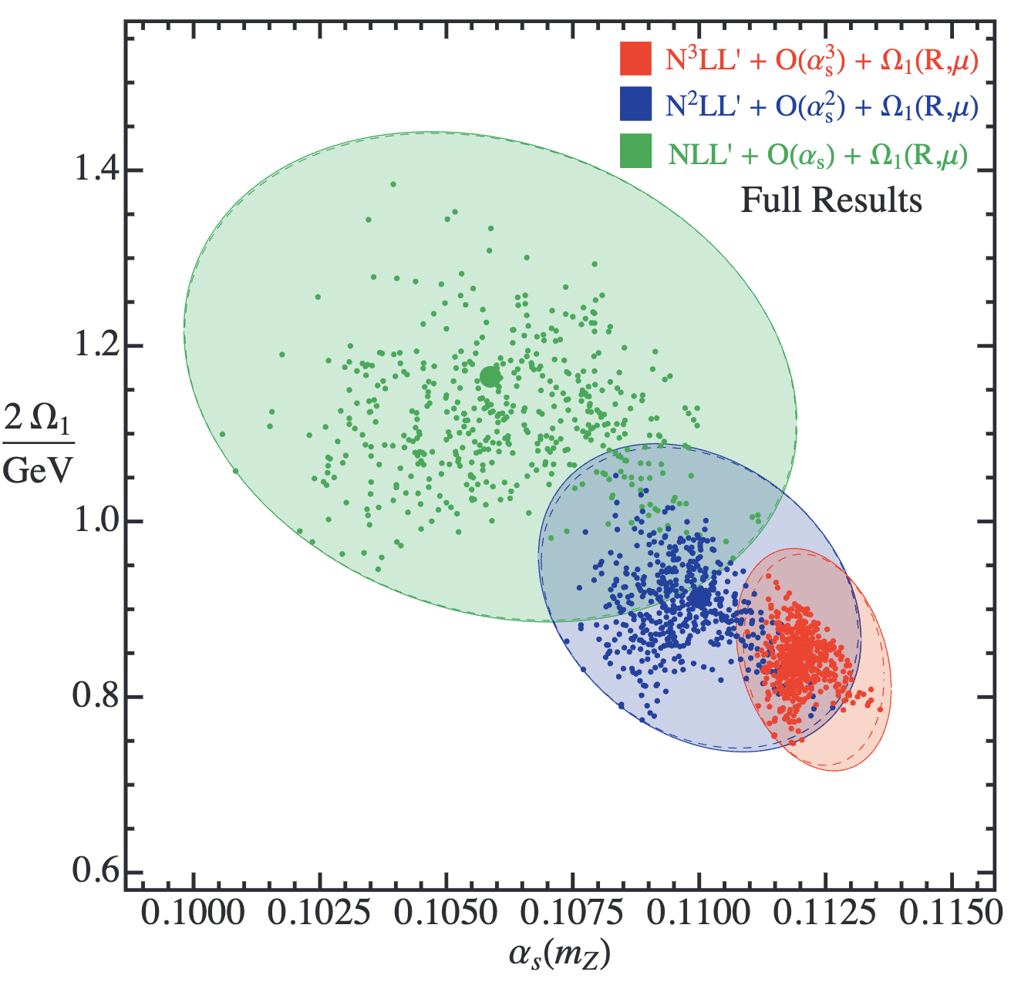
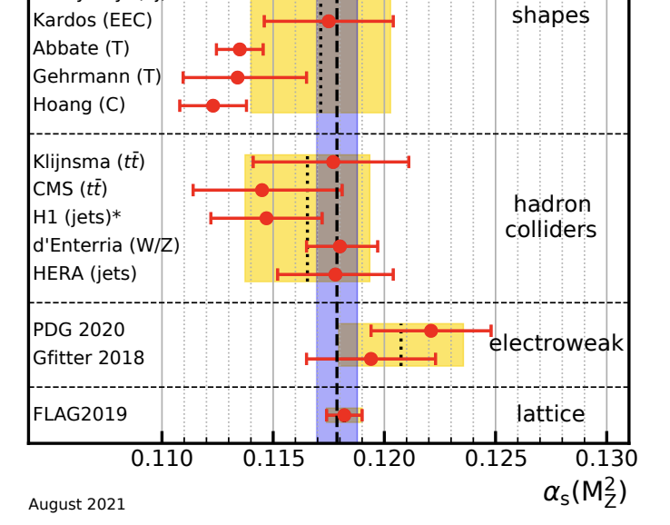
Event shapes and $α_{s}$
Abbate et al. , PRD 83 (2011) 074021
Hoang et al. , PRD 91 (2015) 094018
$e^{+}e^{-}$ Thrust
$e^{+}e^{-}$ C-parameter
PDG 2021
The event shape methods require the simultaneous fit of the $α_{s}(m_{Z})$ and the first moment of the universal nonperturbative constant $Ω_{1}$, which governs the shift of the distributions in the tail region.

Slide 18
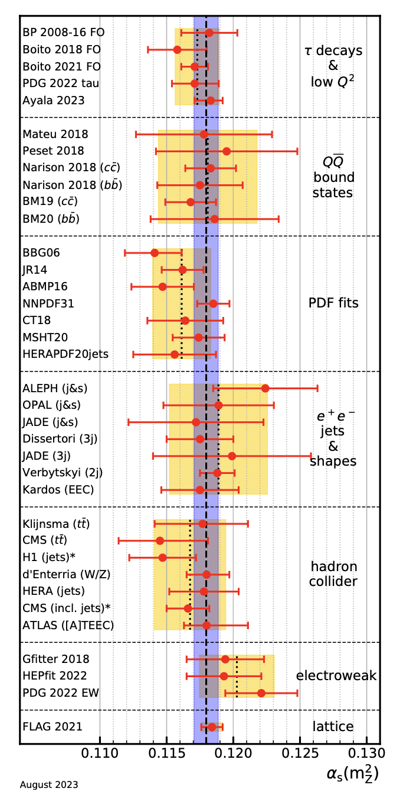
Event shapes and $α_{s}$
PDG 2024
There have been a lot of efforts in determining the $α_{s}$ from $e^{+}e^{-}$ thrust and C parameter, but those analyses led to substantially smaller value of $α_{s}(m_{Z})$.
PDG 2021
Event shape
These have been long standing puzzle, and recently, some questions have been raised about systematic uncertainties due to power corrections from 3-jet region and scheme dependence of renormalon ambiguities.
$$ep$$

Slide 19
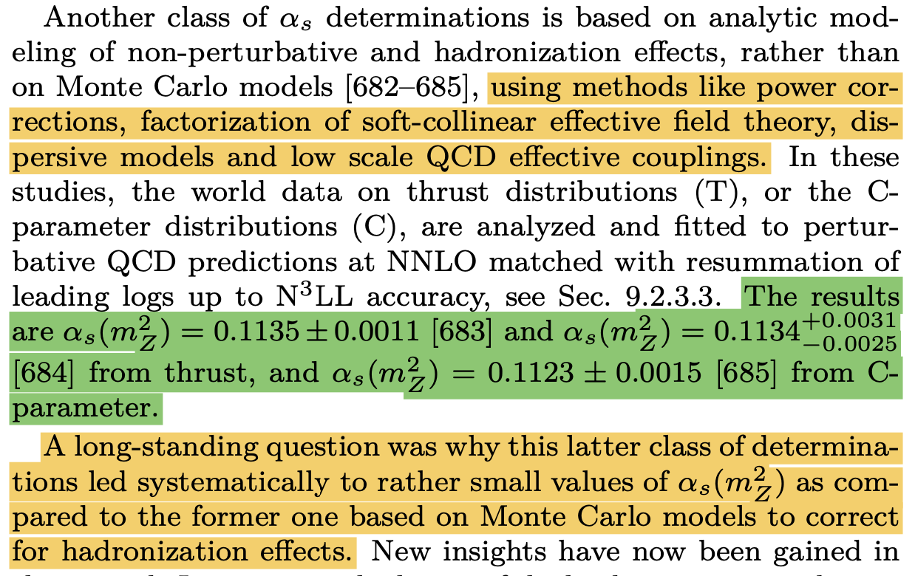
Event shapes and $α_{s}$
PDG 2024
Unlike $e^{+}e^{-}$, DIS provide broad kinematic coverage of $x$-$Q^{2}$, and we expect DIS will provide an opportunity to disentangle the correlations in determining $α_{s}$ and $Ω_{1}$, and allow independent high-precision determination of them.

Slide 20
Theoretical Formalism

Slide 21
Theoretical Formalism
In this work, we compute the $τ_{1}^{b}$ distribution as follows:
$$σ(τ_{1}^{b})=∫dk[$$$$σ_{\text{PT}}^{\text{s}}$$$$+$$$$σ_{\text{PT}}^{\text{ns}}$$$$]\left(τ_{1}^{b}-\frac{k}{Q}\right)$$$$\left[e^{-2δ(R,μ_{S})(d/dk)}F\left(k-2Δ(R,μ_{S})\right)\right]$$
$σ_{\text{PT}}^{\text{s}}$: Singular contribution (Leading Power in SCET)
Represents two-jet events, including all-order log resummation at N³LL level
$σ_{\text{PT}}^{\text{ns}}$: Nonsingular contribution (Power Suppressions)
Represents multi-jet events, estimated using full-QCD fixed-order up to $O(α_{s}^{2})$
$e^{-2δ(R,μ_{S})(d/dk)}F\left(k-2Δ(R,μ_{S})\right)$: Nonperturbative hadronization corrections
Incorporates the nonperturbative shape function $F$, and employs $R$-gap scheme to subtract $O(Λ_{\text{QCD}})$ renormalon ambiguity.

Slide 22
$σ_{\text{PT}}^{\text{s}}$: Singular contribution
If we compute the $τ_{1}^{b}$ distributions in QCD perturbation theory, we find
Singular (diverge as $τ→0$)
Nonsingular (regular as $τ→0$)
$$lnσ(τ)∼α_{s}(\ln^{2}τ+lnτ)$$
$$+α_{s}^{2}(\ln^{3}τ+\ln^{2}τ+lnτ)$$
$$+(\text{non logaritmic terms)}$$
$$+α_{s}^{3}(\ln^{4}τ+\ln^{3}τ+\ln^{2}τ+lnτ)$$
$$α_{s}$$
$$α_{s}^{2}$$
$$+⋯$$
Leading Log
(LL)
Next-to-Leading Log
(NLL)
NNLL
N³LL
With power counting $lnτ∼\frac{1}{α_{s}}$,
$$\frac{1}{α_{s}}$$
$$1$$
$$α_{s}$$
$$α_{s}^{2}$$
In the narrow-jet limit ($τ_{1}^{b}→0$), the log spoils the PT convergence, so should be resummed to all-order in $α_{s}$.
$→$ The logs arise from the ratios of largely separated physical scales (collinear, soft modes)
$→$ Needs factorization theorem! (Soft-collinear effective theory)

Slide 23
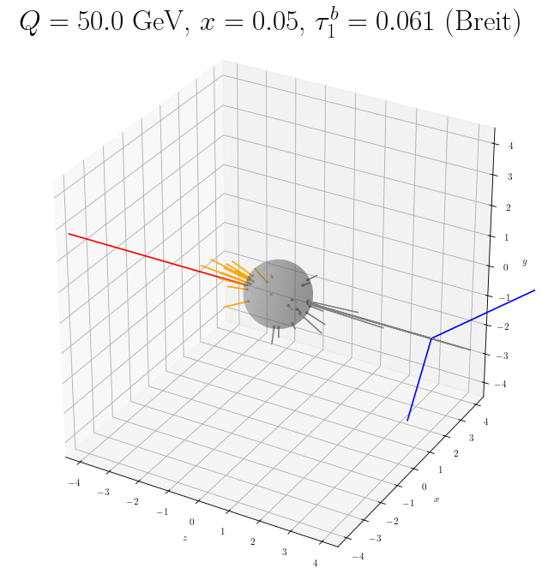
$σ_{\text{PT}}^{\text{s}}$: Momentum scales
$$p^{μ}=(n⋅p,\overline{n}⋅p,|p_{⊥}|)$$
$$n_{z}=(1,0,0,1)$$
$${\overline{n}}_{z}=(1,0,0,-1)$$
$$λ=\frac{λ_{\text{QCD}}}{Q}$$
${\overline{n}}_{z}$-collinear$∼Q(1,λ^{2},λ)$
With this power counting (at leading power), the $n_{z}$-collinear fields do not directly interact with the ${\overline{n}}_{z}$-collinear fields. (Factorization!)
$n_{z}$-collinear$∼Q(λ^{2},1,λ)$
They interact at the hard collision points$∼Q(1,1,1)$.
They could indirectly interact in terms of the soft radiations$∼Q(λ^{2},λ^{2},λ^{2})$, which fill the rapidity gap between $n_{z}$ and ${\overline{n}}_{z}$.
Soft$∼Q(λ^{2},λ^{2},λ^{2})$
The effective Lagrangian describing the collinear and soft degrees of freedoms can be obtained from the original QCD Lagrangian:
$$L_{\text{QCD}}\overset{\text{Integrate out}}{\underset{\text{irrelevant modes}}{→}}L_{\text{EFT}}^{(0)}=L_{n}+L_{\overline{n}}+L_{\text{soft}}$$

Slide 24
$σ_{\text{PT}}^{\text{s}}$: Factorization Theorem
Let us derive the factorization theorem for $τ_{1}^{b}$.
Let us start in QCD:
$$\frac{dσ(x,Q^{2})}{dτ_{1}^{b}}=L_{μν}(x,Q^{2})W^{μν}(x,Q^{2},τ_{1}^{b})$$
Leptonic tensor
Hadronic tensor
$$W^{μν}(x,Q^{2},τ_{1}^{b})=∫d^{4}x^{′}e^{iq⋅x^{′}}⟨P|\overline{q}γ^{μ}q(x^{′})δ(τ_{1}^{b}-{\overset{̂}{τ}}_{1}^{b})\overline{q}γ^{ν}q(0)|P⟩$$
with ${\overset{̂}{τ}}_{1}^{b}|X⟩=τ_{1}^{b}(X)|X⟩$
$$=J^{μ}(x^{′})$$
$$=J^{ν}(0)$$
We match the operators in $W^{μν}$ onto 2-jet operators in SCET:
$$W^{μν}(x,Q^{2},τ_{1}^{b})=∫d^{4}x^{′}\underset{n_{1},n_{2}}{∑}∫d^{3}{\overset{˜}{p}}_{1}d^{3}{\overset{˜}{p}}_{2}e^{i({\overset{˜}{p}}_{2}-{\overset{˜}{p}}_{1})⋅x^{′}}$$
Wilson coefficients
(matching coefficients between QCD and SCET)
$$C_{μ}^{*}({\overset{˜}{p}}_{1},{\overset{˜}{p}}_{2})C_{μ}({\overset{˜}{p}}_{1},{\overset{˜}{p}}_{2})$$
$$×⟨P_{n_{B}}|{\overline{χ}}_{n_{2},{\overset{˜}{p}}_{2}}(x^{′})χ_{n_{1},{\overset{˜}{p}}_{1}}(x^{′})$$
Collinear jet operator in SCET
$$×δ(τ_{1}^{b}-{\overset{̂}{τ}}_{1}^{n_{1}}-{\overset{̂}{τ}}_{1}^{n_{2}}-{\overset{̂}{τ}}_{1}^{s})$$
$$χ_{n}=W_{n}ξ_{n}$$
$$×{\overline{χ}}_{n_{1},{\overset{˜}{p}}_{1}}χ_{n_{2},{\overset{˜}{p}}_{2}}(0)|P_{n_{B}}⟩$$
Collinear Wilson line
(from hard or $\overline{n}$ lines)
Collinear quark field

Slide 25
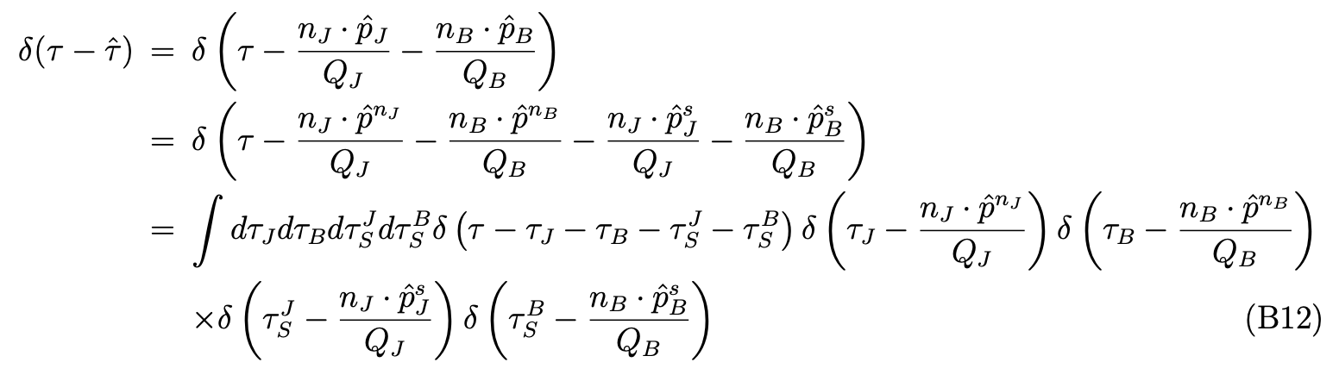
$σ_{\text{PT}}^{\text{s}}$: Factorization Theorem
Even though we factorized the $n$ and $\overline{n}$ collinear fields, they still interact with the soft fields through the LP SCET Lagrangian, and we can decouple the collinear fields from the soft fields by redefining the collinear fields using soft Wilson lines as follows:
$$χ_{n}→Y_{n}χ_{n}$$
Implementing this to the hadronic tensor, we find
$$W_{μν}(x,Q^{2},τ_{1}^{b})=∫d^{4}x^{′}\underset{n_{1},n_{2}}{∑}∫d^{3}{\overset{˜}{p}}_{1}d^{3}{\overset{˜}{p}}_{2}e^{i({\overset{˜}{p}}_{2}-{\overset{˜}{p}}_{1})⋅x^{′}}$$
Wilson coefficients
(matching coefficients between QCD and SCET)
$$C_{μ}^{*}({\overset{˜}{p}}_{1},{\overset{˜}{p}}_{2})C_{μ}({\overset{˜}{p}}_{1},{\overset{˜}{p}}_{2})$$
$$×⟨P_{n_{B}}|$$
$${\overline{χ}}_{n_{2},{\overset{˜}{p}}_{2}}(x^{′})$$
$$\overline{T}\left[Y_{n_{2}}^{†}(x)Y_{n_{1}}(x)\right]$$
$$χ_{n_{1},{\overset{˜}{p}}_{1}}(x^{′})$$
Now, collinear fields and soft fields are factorized and computed separately at each specific physical scale.
$$×δ(τ_{1}^{b}-{\overset{̂}{τ}}_{1}^{n_{1}}-{\overset{̂}{τ}}_{1}^{n_{2}}-{\overset{̂}{τ}}_{1}^{s})$$
$$×$$
$${\overline{χ}}_{n_{1},{\overset{˜}{p}}_{1}}$$
$$T\left[Y_{n_{1}}^{†}(0)Y_{n_{2}}(0)\right]$$
$$χ_{n_{2},{\overset{˜}{p}}_{2}}(0)$$
$$|P_{n_{B}}⟩$$
Similarly, we can factorize the measurement function inserting delta function identities:

Slide 26
$σ_{\text{PT}}^{\text{s}}$: Factorization Theorem
Rearranging operators and performing integrations in label momenta, we finally find
Hard function
Measurement function
$$W_{μν}(x,Q^{2},τ_{1}^{b})=∫d^{2}{\overset{˜}{p}}_{⊥}∫dτ_{J}dτ_{B}dτ_{S}C_{μ}^{*}(Q^{2},μ)C_{μ}(Q^{2},μ)δ\left(τ_{1}^{b}-\frac{t_{J}}{Q^{2}}-\frac{t_{B}}{Q^{2}}-\frac{k_{S}}{Q}\right)$$
Soft function
$$×⟨0|\left[Y_{n_{J}^{′}}^{†}Y_{n_{B}^{′}}\right](0)δ(k_{S}-n_{J}^{′}{\overset{̂}{p}}_{J}^{′}-n_{B}^{′}⋅{\overset{̂}{p}}_{B}^{′})\left[Y_{n_{B}^{′}}^{†}Y_{n_{J}^{′}}\right](0)|0⟩$$
(Prime for transforming to hemisphere soft function)
Beam function
$$×⟨P_{n_{B}}|{\overline{χ}}_{n_{B}}(0)δ(Qτ_{B}-n_{B}⋅{\overset{̂}{p}}^{n_{B}}[δ({\overline{n}}_{B}⋅q+{\overline{n}}_{B}⋅P)δ^{2}({\overset{˜}{p}}_{⊥}-P_{⊥})χ_{n_{B}}](0)|P_{n_{B}}⟩$$
Jet function
$$×⟨0|χ_{n_{J}}(0)δ(Qτ_{J}-n_{J}⋅{\overset{̂}{p}}^{n_{J}})δ({\overline{n}}_{J}⋅q+{\overline{n}}_{J}⋅P)δ^{2}(q_{⊥}+{\overset{˜}{p}}_{⊥}+P_{⊥})χ_{n_{J}}(0)|0⟩$$
+ (permutations)
Now each function no longer interacts with each other and can be computed separately in perturbation theory.
Each function has specific energy scale and through the RG evolution, we can resume logs.

Slide 27
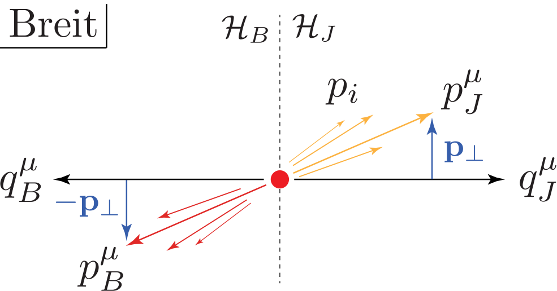
$σ_{\text{PT}}^{\text{s}}$: Singular contribution
The SCET factorization formula for $τ_{1}^{b}$ distribution is given by
arXiv:1303.6952
Kang, Lee, Stewart
Measurement function for $τ_{1}^{b}$
Single variable soft function
$$\frac{dσ}{dxdQ^{2}dτ_{1}^{b}}=\frac{dσ_{0}^{b}}{dxdQ^{2}}∫dt_{J}dt_{B}dk_{S}δ\left(τ_{1}^{b}-\frac{t_{J}}{Q^{2}}-\frac{t_{B}}{Q^{2}}-\frac{k_{S}}{Q}\right)S(k_{S},μ)$$
$$×∫d^{2}p_{⊥}J_{q}(t_{J}-p_{⊥}^{2},μ)\left[H_{q}^{b}(y,Q^{2},μ)B_{q}(t_{B},x,p_{⊥}^{2},μ)+(q→\overline{q})\right],$$
Quark jet function
Hard function
Quark beam function
where Born-level cross section
$$\frac{dσ_{0}^{b}}{dxdQ^{2}}=\frac{2πα_{\text{em}}^{2}}{Q^{4}}\left[(1-y)^{2}+1\right]$$
(Note that $Q^{2}=sxy$)
With $t_{J}→t_{J}+p_{⊥}^{2},\text{and}t_{B}→t_{B}-p_{⊥}^{2},$we can confine the $p_{⊥}^{2}$ integration to the beam function only:
$${\overset{̂}{B}}_{q}(t_{B},x,μ)=∫d^{2}p_{⊥}B_{q}(t_{B}-p_{⊥}^{2},x,p_{⊥}^{2},μ)$$

Slide 28
$σ_{\text{PT}}^{\text{s}}$: Fixed-order functions
Our target theory precision is N³LL + $O(α_{s}^{2})$, so we need 2-loop fixed-order expressions for each parts of FT:
Hard function: $qq→qq$ through neutral currents ($γ^{*},Z^{*}$): 2-loop
arXiv:hep-ph/0605068,
Idilbi, Ji, Yuan
arXiv:hep-ph/0607228,
Becher, Neubert, Pecjak
arXiv:1006.3080,
Abbate, Fickinger, Hoang, Mateu, Stewart
arXiv:hep-ph/0607228,
Becher, Neubert, Pecjak
Quark jet function: 2-loop
arXiv:1105.3676,
Kelley, Schabinger, Schwartz, Zhu
Soft function: 2-loop
$τ_{1}^{b}$ quark beam function: ${\overset{̂}{B}}_{q}(t_{B},x,μ)=∫d^{2}p_{⊥}B_{q}(t_{B}-p_{⊥}^{2},x,p_{⊥}^{2},μ)$
$B_{q}(t,x,k_{⊥}^{2},μ)$ is the $k_{⊥}$-dep. beam function, $B_{i}(t,x,k_{⊥}^{2},μ)=I_{ij}(t,x/ξ,k_{⊥}^{2},μ)⊗_{ξ}f_{j}(ξ,μ)$
Known to 2-loop.
PDF for parton $j$
arXiv:1401.5478,
Gaunt, Stahlhofen, Tackmann
arXiv:1409.8281,
Gaunt, Stahlhofen

Slide 29
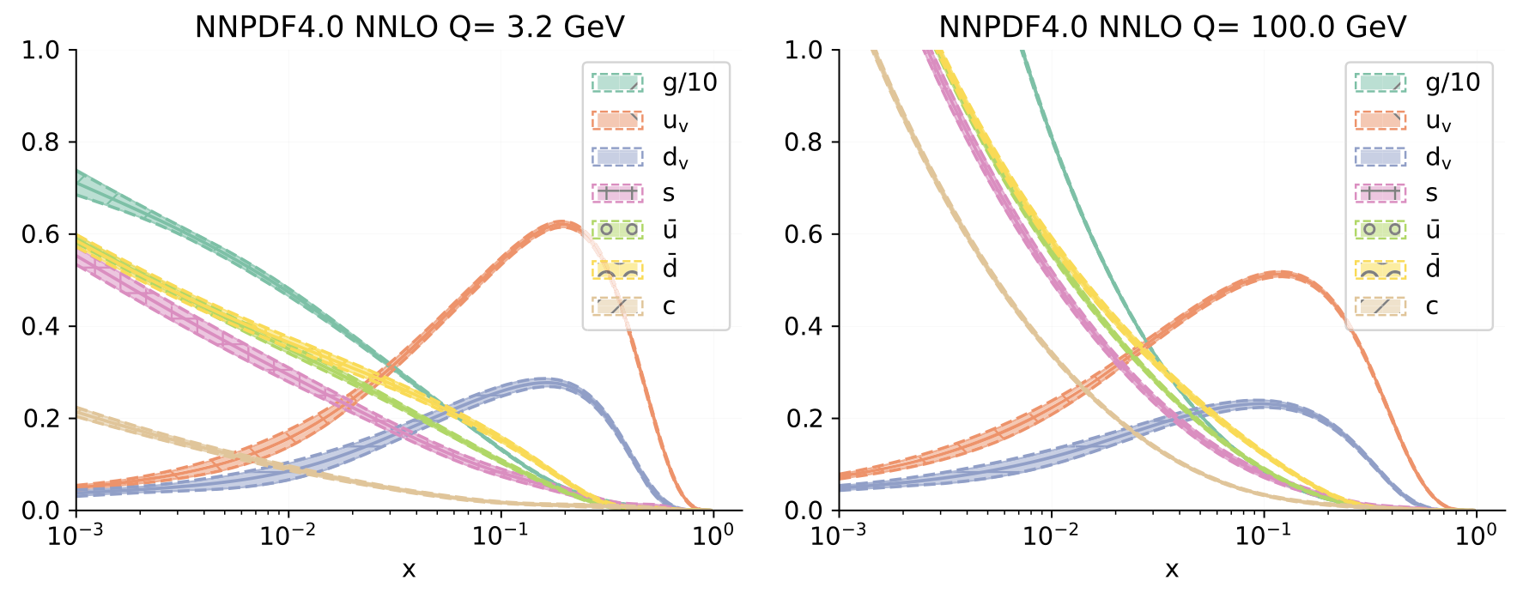
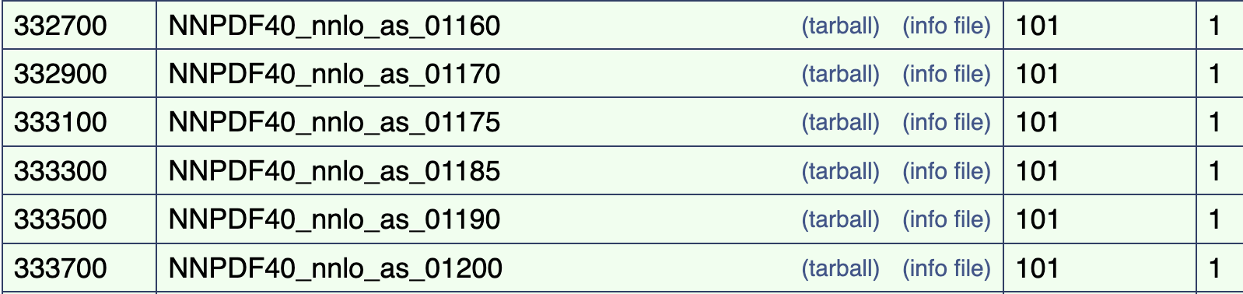
$σ_{\text{PT}}^{\text{s}}$: PDF
$τ_{1}^{b}$ quark beam function: ${\overset{̂}{B}}_{q}(t_{B},x,μ)=∫d^{2}p_{⊥}B_{q}(t_{B}-p_{⊥}^{2},x,p_{⊥}^{2},μ)$
$B_{q}(t,x,k_{⊥}^{2},μ)$ is the $k_{⊥}$-dep. beam function, $B_{i}(t,x,k_{⊥}^{2},μ)=I_{ij}(t,x/ξ,k_{⊥}^{2},μ)⊗_{ξ}f_{j}(ξ,μ)$
PDF for parton $j$
We use NNPDF4.0 NNLO PDF set implemented in LHAPDF.
PDFs are determined w.r.t. $α_{s}$ value.
Should change PDFs for different $α_{s}$ simultaneously.

Slide 30
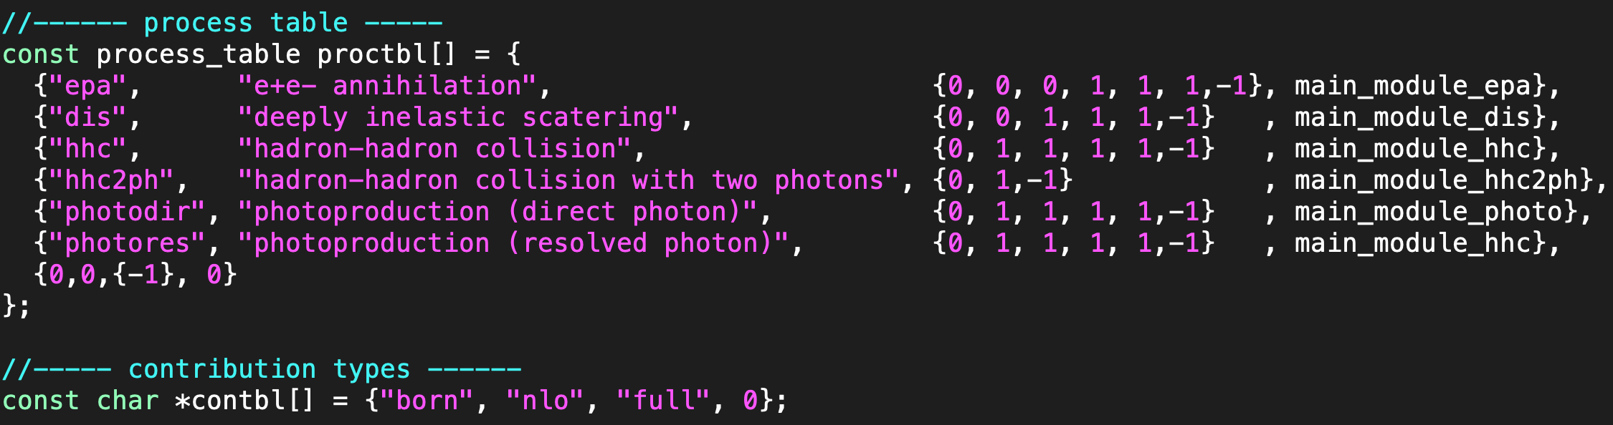
$σ_{\text{PT}}^{\text{ns}}$: Nonsingular contribution
Nonsingular contributions from fixed-order full QCD calculations:
LO nonsingular:
arXiv:1407.6706
Kang, Lee, Stewart
$$\frac{dσ_{\text{ns}}}{dτ_{1}^{b}}=\frac{dσ_{\text{QCD}}}{dτ_{1}^{b}}-\frac{dσ_{\text{s}}}{dτ_{1}^{b}}$$
NLOJet++ is the C++ program for calculating LO and NLO QCD jet cross sections based on Catani-Seymour dipole subtraction method. (Author: Zoltan Nagy at DESY)
arXiv:hep-ph/9605323
Catani and Seymour
arXiv:hep-ph/0307268
Nagy
$e^{+}e^{-}$, $ep$, $pp$ and photo production processes.

Slide 31
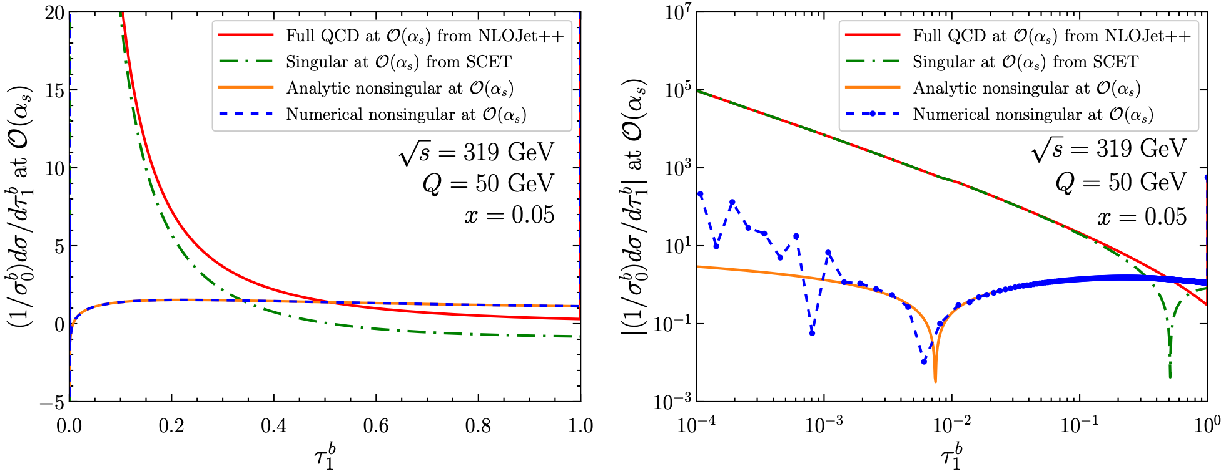
$σ_{\text{PT}}^{\text{ns}}$: Nonsingular at LO
Analytic 1-loop nonsingular
arXiv:1407.6706
Kang, Lee, Stewart
From NLOJet++, we obtain the fixed-order 1-loop full QCD cross section (red) and we subtract the SCET singular contribution (green) to obtain the nonsingular contribution (orange). (Remove double counting)
The analytic results are available at 1-loop (orange) and the numerical results from NLOJet++ agree well with it before the numerical noise kicks in for very small $τ_{1}^{b}$.

Slide 32
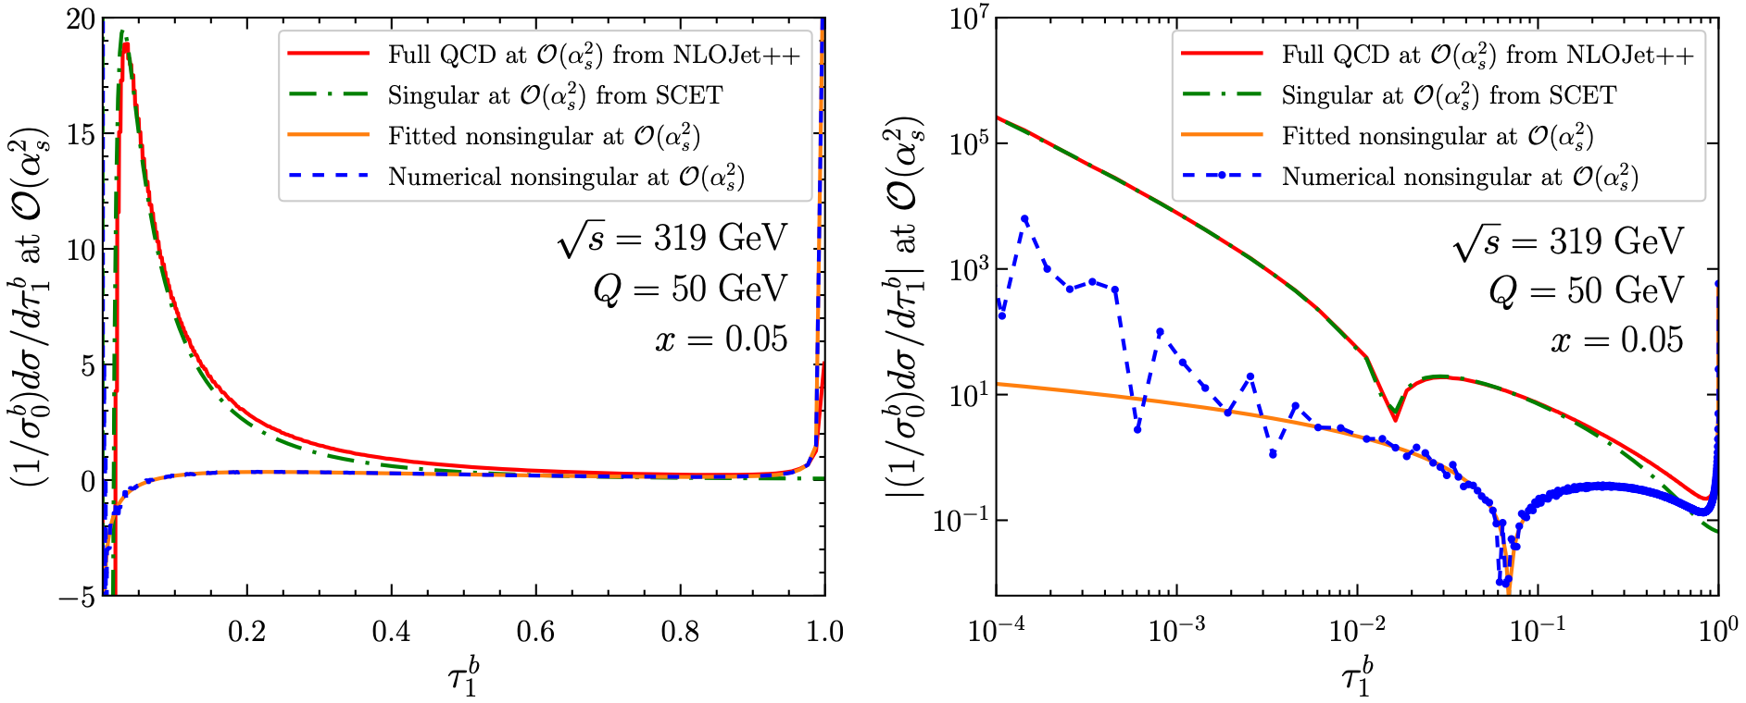
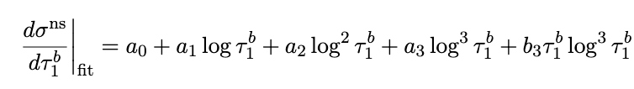
$σ_{\text{PT}}^{\text{ns}}$: Nonsingular at NLO
At 2-loop, there are no analytic results, so we should use NLOJet++ results (blue).
The numerical results are not reliable below $τ_{1}^{b}∼{10}^{-2}$, so instead of using the numerical results directly, we use the weighted fit of the numerical results using the following fit function (orange):
$$χ^{2}/\text{d.o.f.}=1.02$$

Slide 33
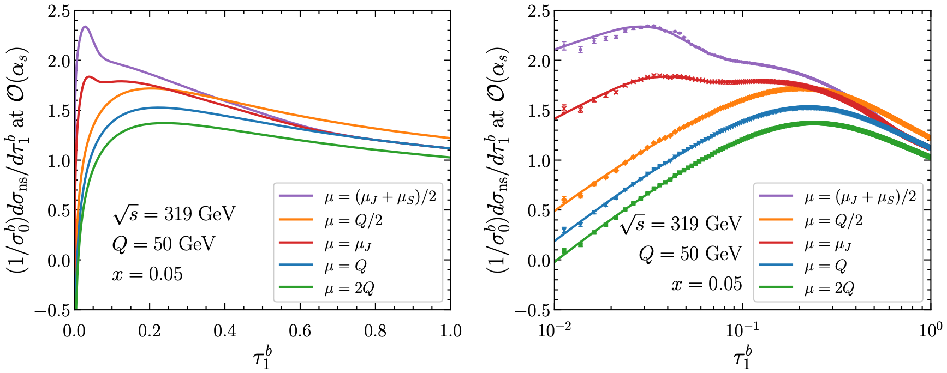
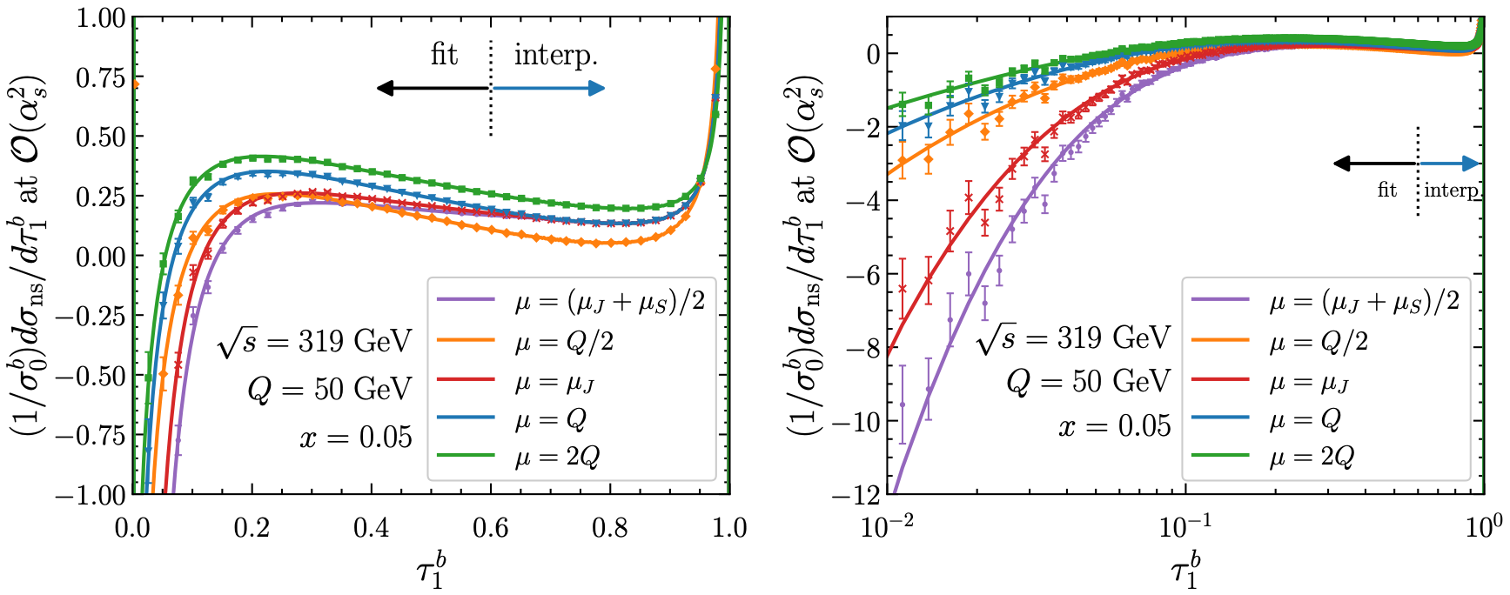
$σ_{\text{PT}}^{\text{ns}}$: Scale variations
In order to estimate the perturbative uncertainties in the nonsingular contributions, we consider the 5 scale variation in the fixed-order calculations:
1-loop nonsingular
2-loop nonsingular

Slide 34
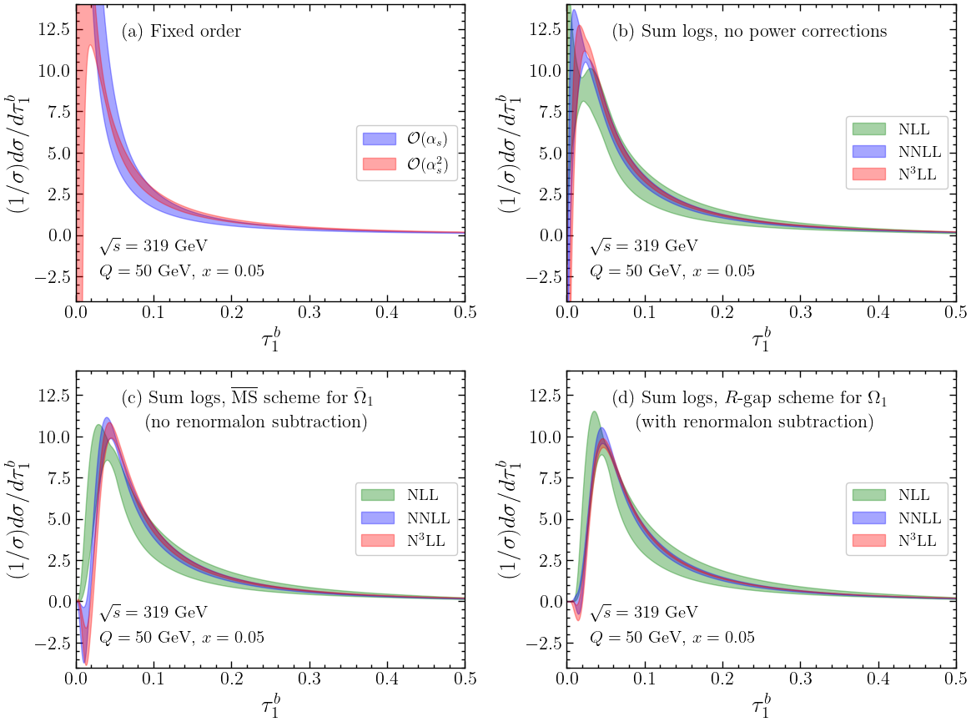
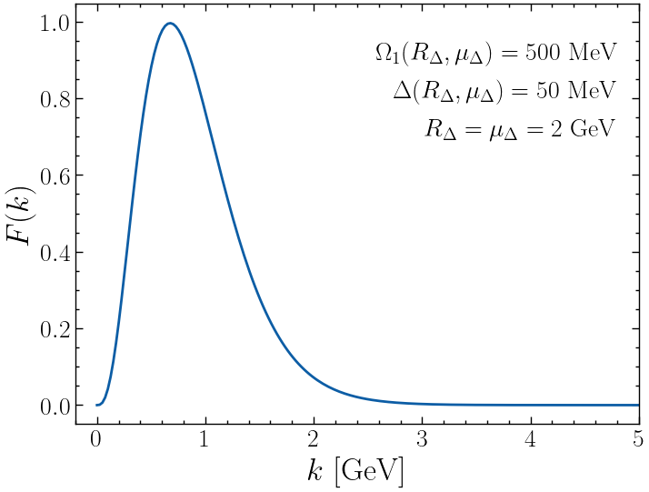
NP corr.: Shape function
$$S(k,μ)=∫dk^{′}S_{\text{pert}}(k-k^{′},μ)F(k^{′})$$
$$\frac{dσ}{dτ_{1}^{b}}(τ_{1}^{b})=∫dk\frac{dσ_{\text{pert}}}{dτ_{1}^{b}}\left(τ_{1}^{b}-\frac{k}{Q}\right)F(k)$$
According to OPE,
$$\frac{dσ}{dτ_{1}^{b}}(τ_{1}^{b})=\left\{\frac{dσ_{\text{pert}}(τ_{1}^{b})}{dτ_{1}^{b}}-\frac{2Ω_{1}}{Q}\frac{dσ_{\text{pert}}^{2}(τ_{1}^{b})}{{dτ_{1}^{b}}^{2}}\right\}\left[1+O(Λ_{\text{QCD}}/(τ_{1}^{b}Q))\right]$$
$2Ω_{1}$ is the 1st moment of $F(k)$:
$$2Ω_{1}=∫dkkF(k)$$
In the tail region, $τ_{1}^{b}→τ_{1}^{b}-2Ω_{1}/Q$ (translation!)
Simplest implementation with $c_{0}=1$ and $λ=0.9\text{GeV}$:

Slide 35
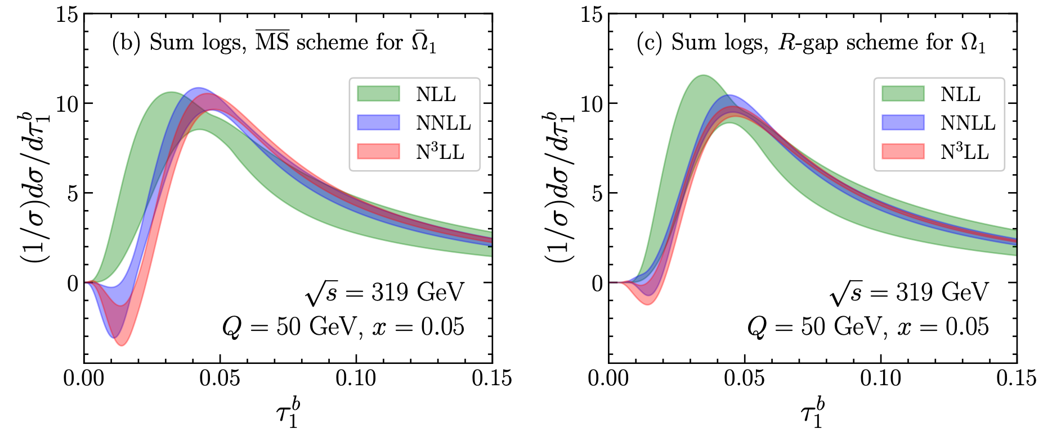
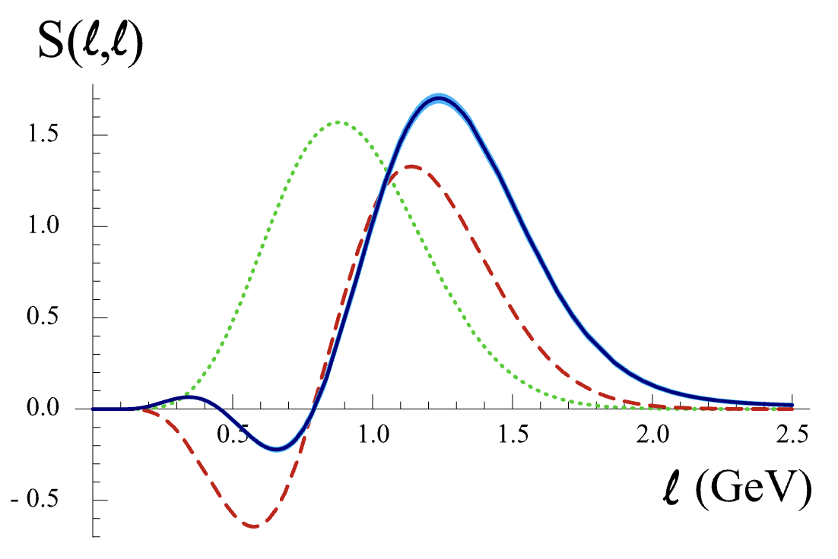
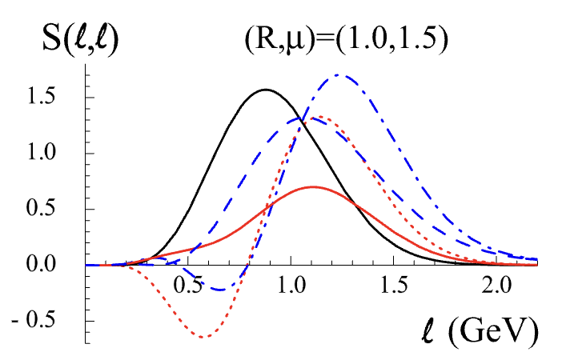
NP corr.: Renormalon ambiguity
We employ the $R$-gap scheme introduced in [arXiv:0806.3852, Hoang, Kluth].
Before renormalon subtraction
After renormalon subtraction
($R$-gap scheme)
$O(Λ_{\text{QCD}})$ renormalon ambiguity
Renormalon subtraction

Slide 36
Results and comparison with HERA data

Slide 37
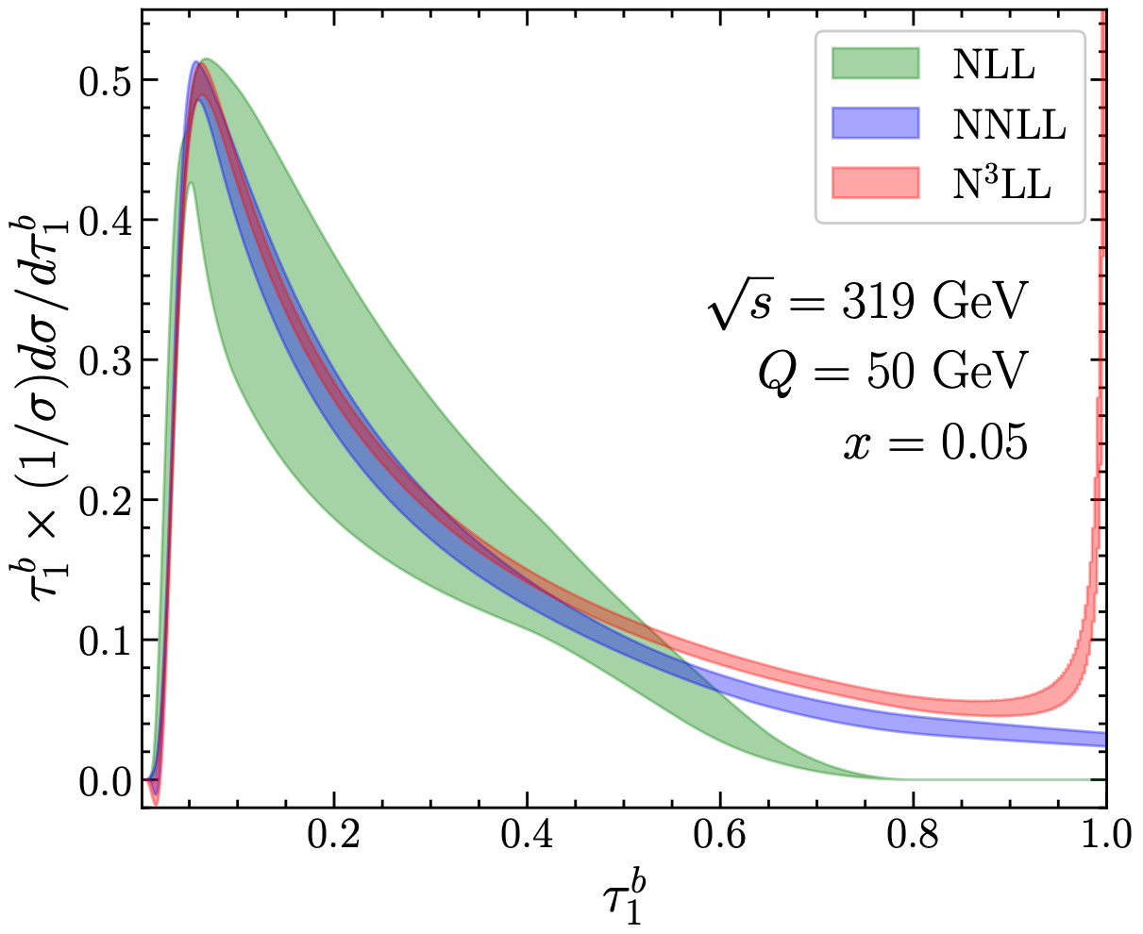
Final N³LL + $O(α_{s}^{2})$ prediction
Relevant to HERA setup
Good perturbative convergence of the distributions, especially in the tail region.
Can observe a peak as $τ_{1}^{b}→1$, which characterizes the events with nearly empty jet hemisphere.
$$τ_{1}^{b}\overset{\text{Breit}}{=}1-\frac{2}{Q}\underset{i∈H_{J}}{∑}(p_{i})_{z}=τ_{Q}$$

Slide 38
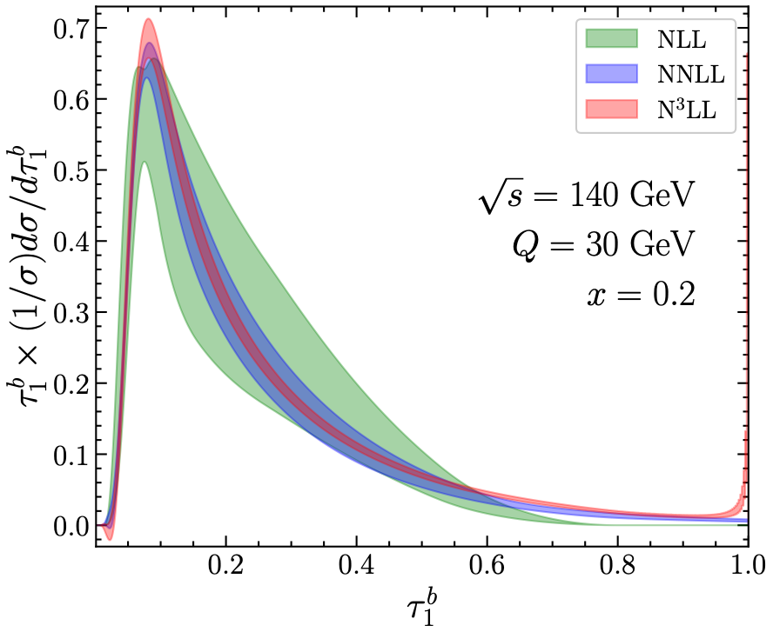
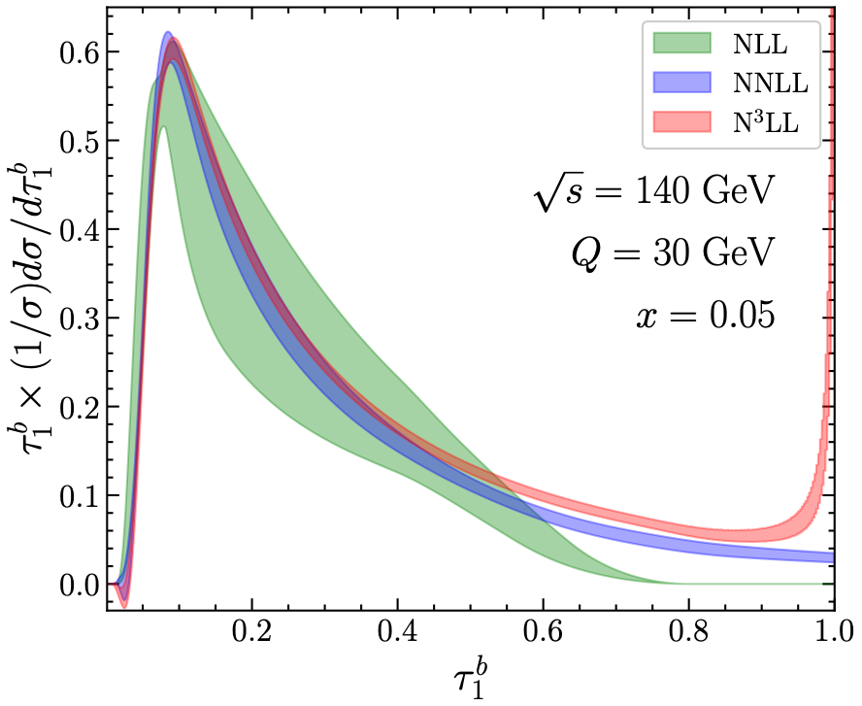
Final N³LL + $O(α_{s}^{2})$ prediction
Relevant to EIC setup
Good perturbative convergence
Can observe the peak as $τ_{1}^{b}→1$, and this feature is more pronounced at smaller $x$.

Slide 39
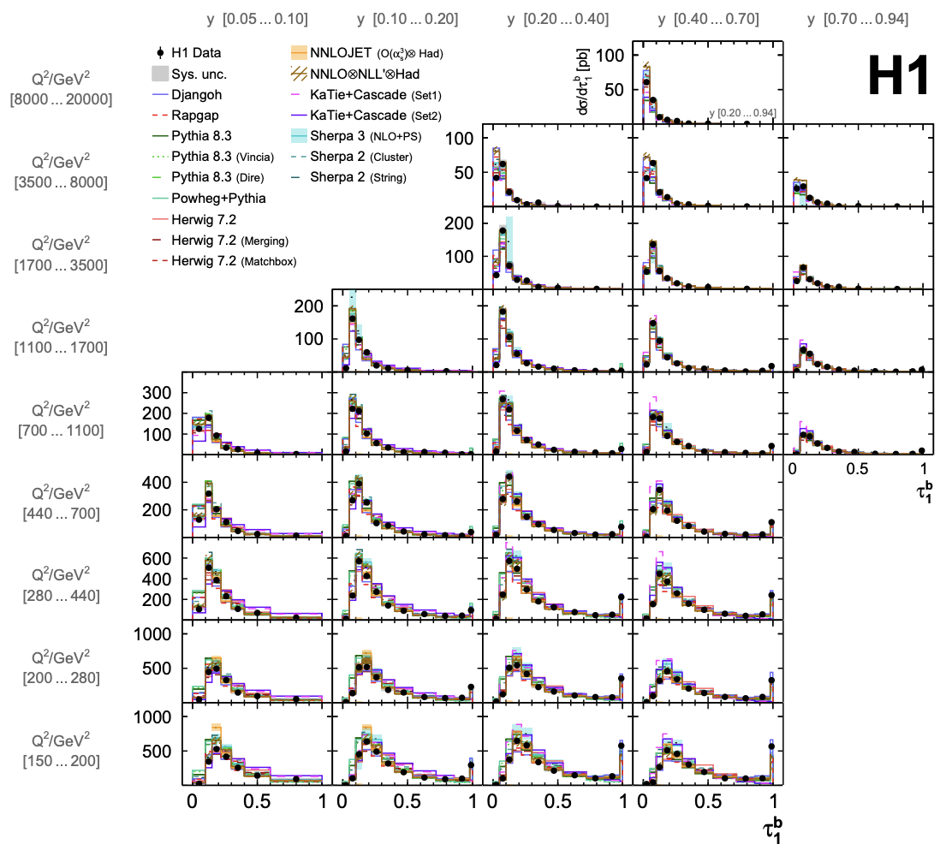
HERA H1 measurement
The HERA H1 collaboration reported measurements of $τ_{1}^{b}$ in DIS using data collected between 2003-2007 $\sqrt{s}=319\text{GeV}$, with integrated luminosity of $L=351.1{\text{pb}}^{-1}$.
arXiv:2403.10109
H1 Collaboration
The distribution in $τ_{1}^{b}$ given by
$∫_{Δy}dy∫_{ΔQ^{2}}dQ^{2}\frac{dσ}{dydQ^{2}dτ_{1}^{b}}$
We compare our theoretical predictions with these measurements (highlighted in the red box).

Slide 40
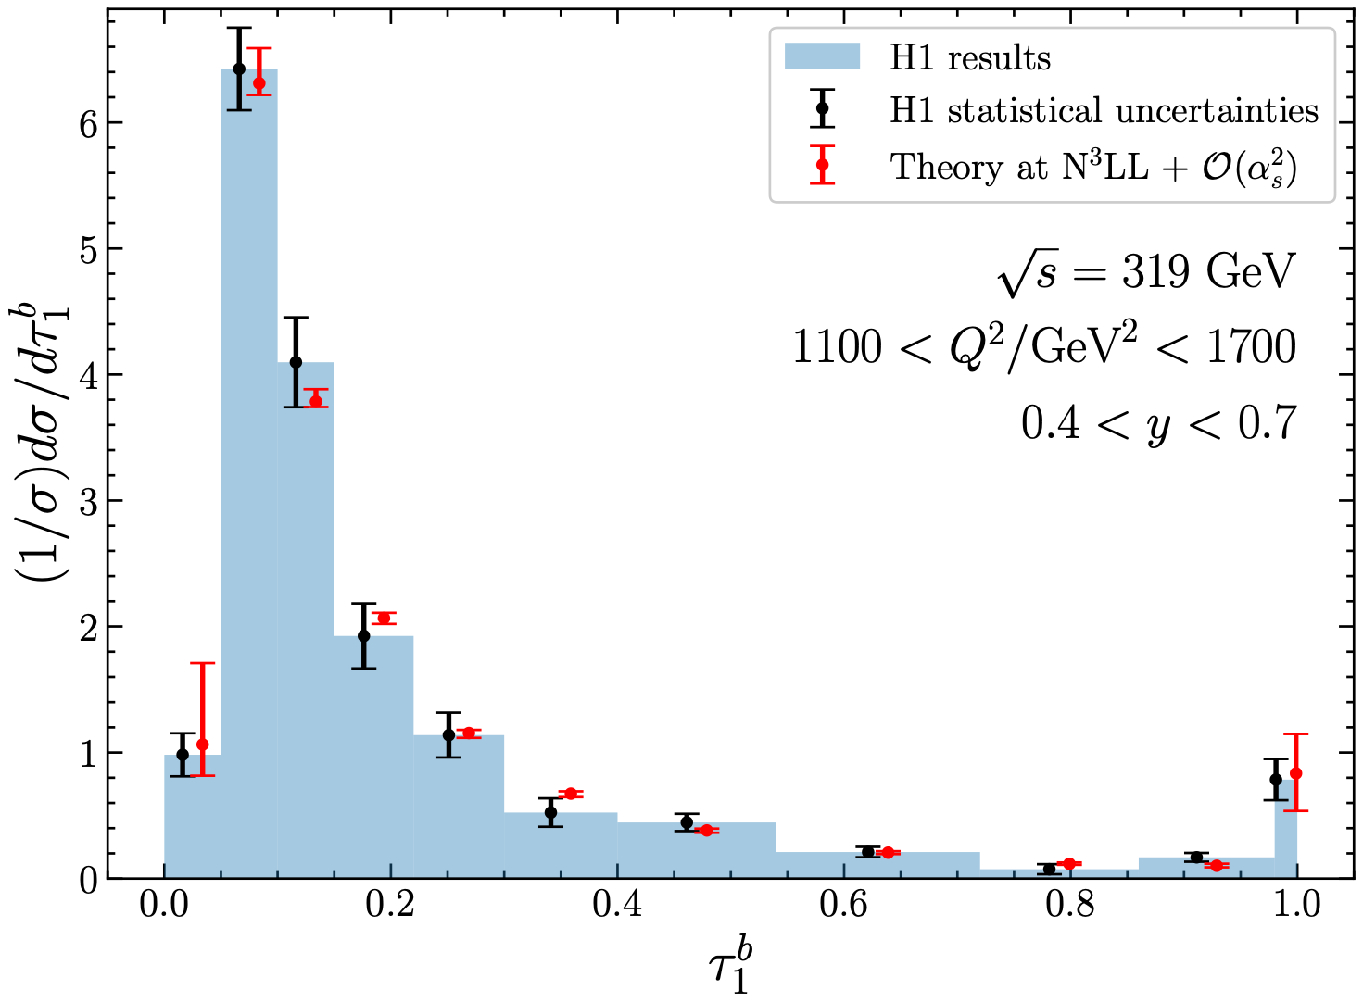
HERA H1 measurement

Slide 41
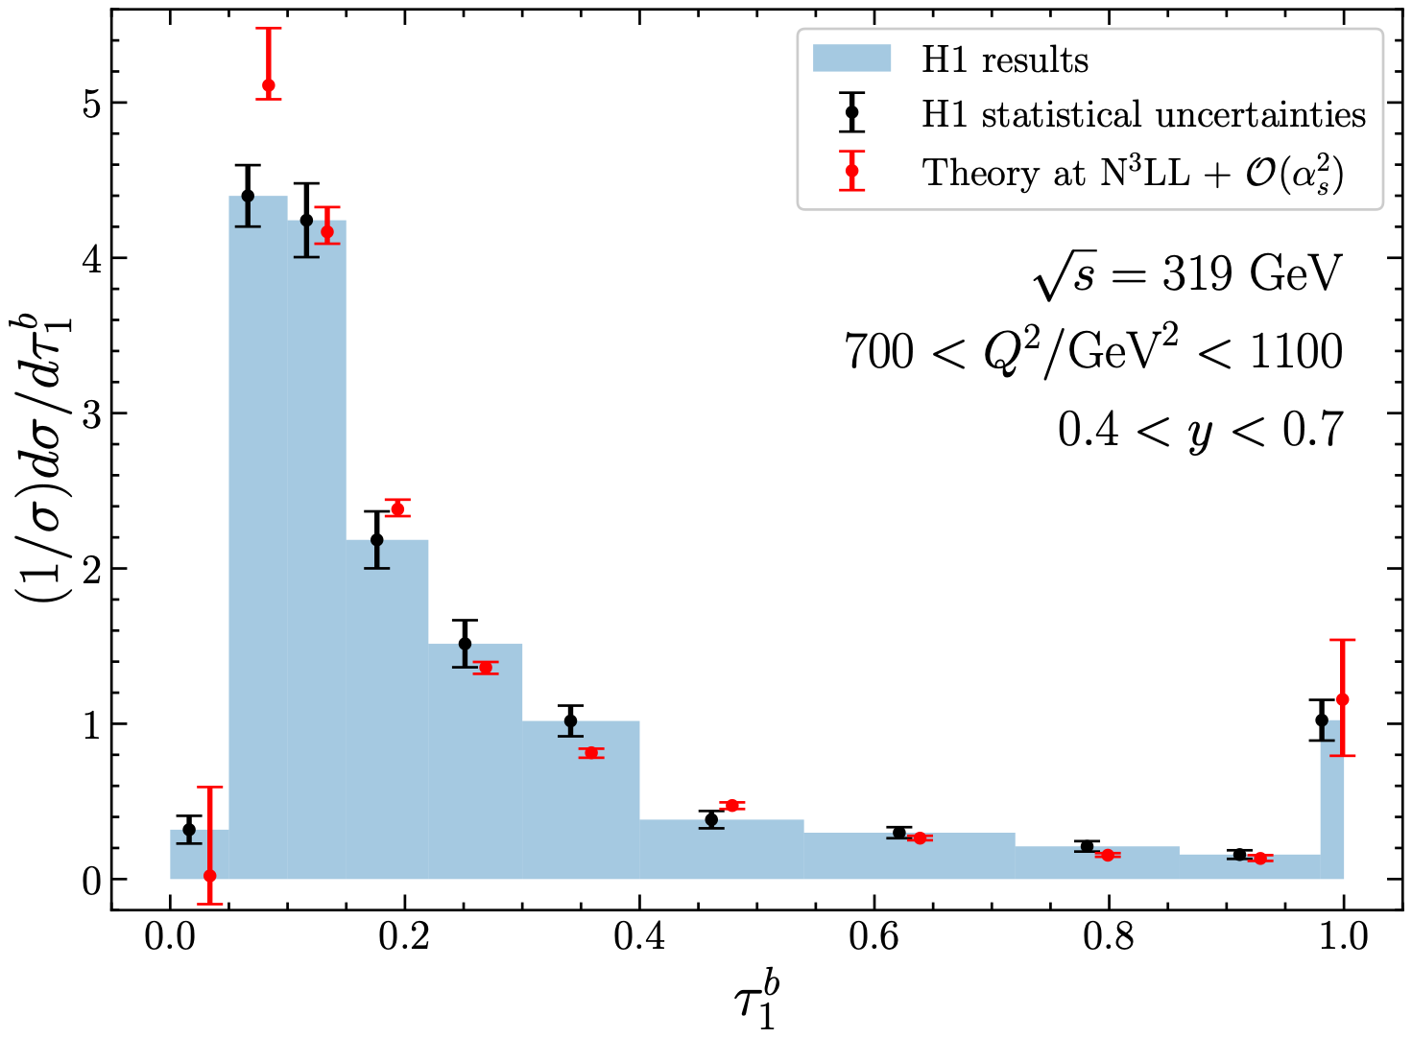
HERA H1 measurement

Slide 42
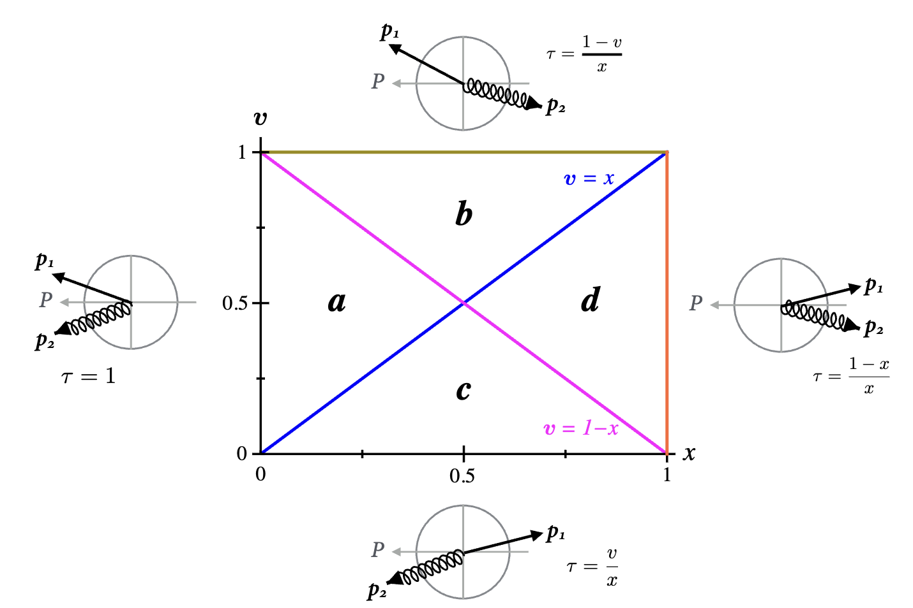
Peak as $τ_{1}^{b}→1$
$τ_{1}^{b}→1$ characterizes events where nearly all final-state particles are confined to the beam hemisphere. (Empty jet hemisphere)
arXiv:1407.6706
Kang, Lee, Stewart
$$τ_{1}^{b}\overset{\text{Breit}}{=}1-\frac{2}{Q}\underset{i∈H_{J}}{∑}(p_{i})_{z}=τ_{Q}$$
This contribution becomes increasingly significant as $x→0$.
$$H_{J}\text{is empty}$$
$$τ_{1}^{b}=1$$

Slide 43

$$τ_{1}^{b}=0.998$$

Slide 44
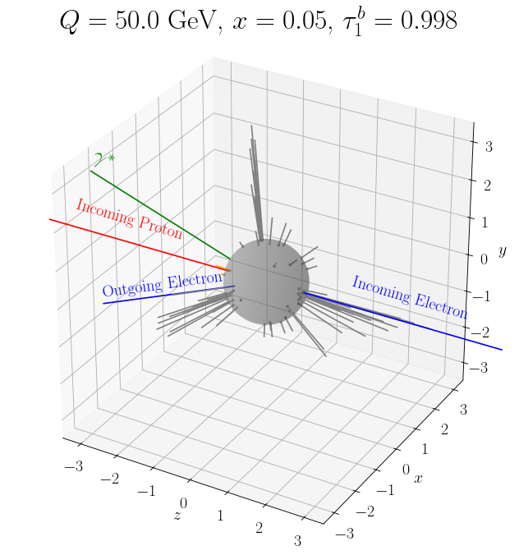
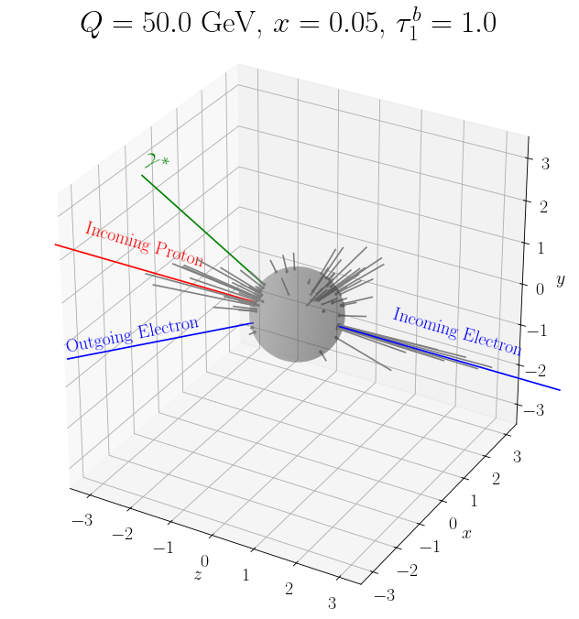
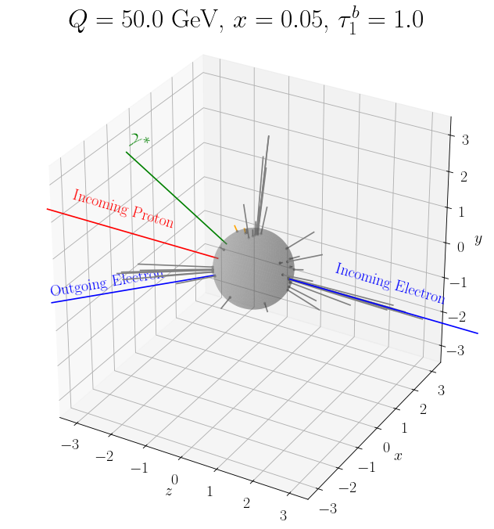
Peak as $τ_{1}^{b}→1$
In general, events with $τ_{1}^{b}∼1$ describe the multi-jet events (more than 2 jets):
The di-jet SCET factorization cannot describe these events, and we estimated these contributions using the full QCD 2-loop cross sections (using NLOJet++).

Slide 45
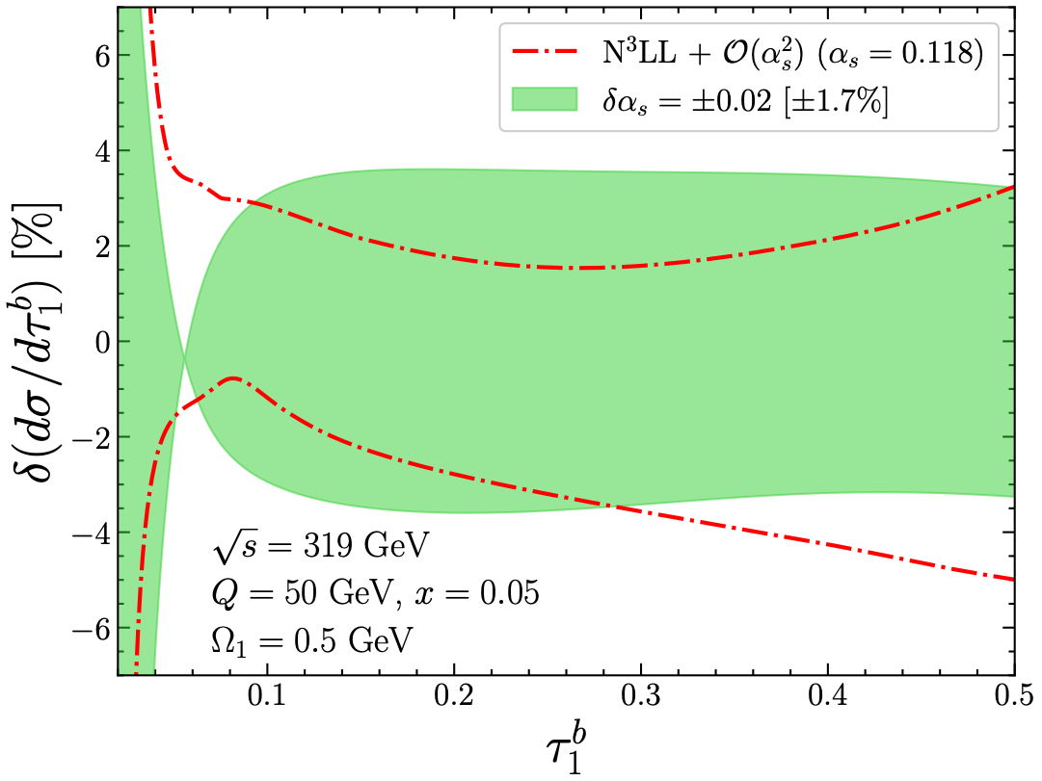
$α_{s}$ and $Ω_{1}$ sensitivities
$$Δα_{s}(m_{Z})$$
Requires uncertainties below 4% for $δα_{s}=±0.02$

Slide 46
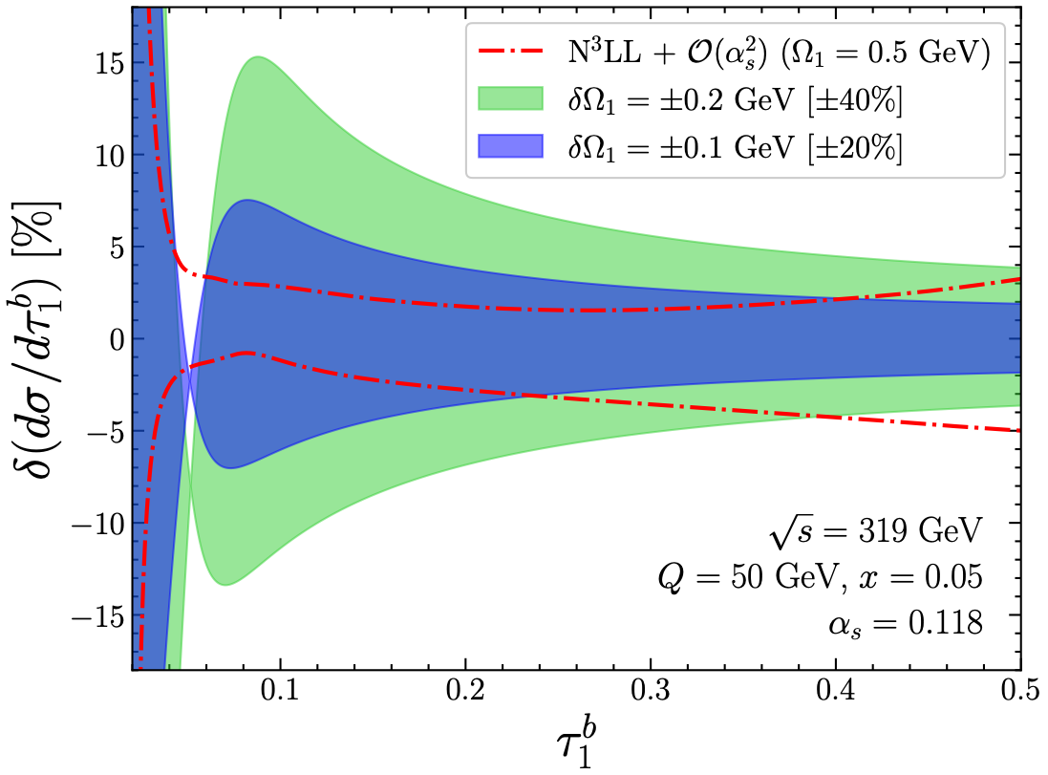
$α_{s}$ and $Ω_{1}$ sensitivities
$$ΔΩ_{1}$$
Requires uncertainties below 5% for $δΩ_{1}=±100\text{MeV}$

Slide 47


PDF uncertainties
PDF uncertainties are well within our theoretical estimation of uncertainties at N³LL + $O(α_{s}^{2})$.

Slide 48


Uncertainties w.r.t. $x$ and $Q^{2}$
HERA ($\sqrt{s}=319\text{GeV}$)
EIC ($\sqrt{s}=140\text{GeV}$)
Our predictions exhibit uncertainties below 4% across large range of $x$ and $Q$.

Slide 49
Summary
$τ_{1}^{b}$ is an DIS event shape with significant advantages for experimental measurements.
As a global observable, it allows for high-precision theoretical predictions.
We computed the $τ_{1}^{b}$ distributions at N3LL + $O(α_{s}^{2})$ accuracy, incorporating power corrections and renormalon subtractions for NP soft physics.
With recent HERA measurements and future EIC results, $τ_{1}^{b}$ provides an unique event shape method for the $α_{s}$ and $Ω_{1}$ determination in DIS.
It is also sensitive to hadron PDFs, making it a potential tool for probing parton distribution functions.
Thanks!

Slide 50
Backup

Slide 51




Shape function: Higher moment
$$\frac{dσ}{dτ_{1}^{b}}(τ_{1}^{b})=∫dk\frac{dσ_{\text{pert}}}{dτ_{1}^{b}}\left(τ_{1}^{b}-\frac{k}{Q}\right)F(k)$$
Operator Product Expansion
$$\frac{dσ}{dτ_{1}^{b}}(τ_{1}^{b})=\left\{\frac{dσ_{\text{pert}}(τ_{1}^{b})}{dτ_{1}^{b}}-\frac{2Ω_{1}}{Q}\frac{dσ_{\text{pert}}^{2}(τ_{1}^{b})}{{dτ_{1}^{b}}^{2}}\right\}\left[1+O(Λ_{\text{QCD}}/(τ_{1}^{b}Q))\right]$$
Implementing different higher-moment modify the $τ_{1}^{b}$ distributions in the peak region, $τ_{\text{merge}}∼\frac{3\text{GeV}}{Q}$
First nontrivial extension of shape function

Slide 52


SCET FT for $τ_{1}^{b}$: Resummation
Analytic 1-loop nonsingular
arXiv:1407.6706
Kang, Lee, Stewart
4-loop cusp anomalous dimension
arXiv:1911.10174
Henn, Korchemsky, Mistlberger
Numerical 2-loop (NLOJET++)
The resulting FT for the cumulant singular distributions after resummation:
Log resummation
Lepton parts and PDFs
Fixed-order functions
(Coefficients of plus distributions)
Convolutions of plus distributions
(momentum space formulation)
$K\text{and}Ω$ are the functions of the scales $μ_{H,B,J,S}$ and the $μ_{\text{goal}}$ (arbitrary scale, usually set to be $μ_{\text{goal}}∼μ_{J,B}$)

Slide 53



Peaks as $τ_{1}^{b}→1$
Breit frame
$$x=0.05$$
$$H_{B}$$
$$e^{-}$$
$$H_{J}$$
$$γ^{*}$$
$$H_{B}$$
$$H_{J}$$
$$e^{-}$$
CM frame
$$x=0.2$$
In Breit frame, the separation of the $H_{B,J}$ is always $z=0$, regardless of $x$ and $Q$.
$$H_{J}$$
$$γ^{*}$$
However, in the CM frame, the $H_{J}$ takes on cone-like shape, with its opening angle varying based on $x$.
$$e^{-}$$
$$H_{B}$$
Events with $τ_{1}^{b}→1$ provide a quantitative measure of gapped events, where the jet hemisphere is nearly empty.
$$e^{-}$$

Slide 54
Nonsingular: $r_{c}(1)$ test
We can check the numerical results from NLOJET++ in terms of the cumulant of the nonsingular distribution.
$$\frac{dσ_{\text{s}}}{dτ_{1}^{b}}=Aδ(τ_{1}^{b})+{\left[B(τ_{1}^{b})\right]}_{+}$$
arXiv:0806.3852
Hoang and Kluth
$$\frac{dσ_{\text{total}}}{dτ_{1}^{b}}=Aδ(τ_{1}^{b})+{\left[B(τ_{1}^{b})\right]}_{+}+r(τ_{1}^{b})$$
$$\frac{dσ_{\text{ns}}}{dτ_{1}^{b}}=r(τ_{1}^{b})$$
arXiv:1808.07867
Bell, Hornig, Lee, Talbert
Fixed-order total
Integrating the fixed-order total and the singular distribution in $τ_{1}^{b}$ from 0 to 1, we have
$$σ_{\text{total}}=A+∫_{0}^{1}dτ_{1}^{b}r(τ_{1}^{b})$$
$$∫_{0}^{1}dτ_{1}^{b}{\left[B(τ_{1}^{b})\right]}_{+}=0$$
and
$$σ_{\text{s}}=A$$
where we used
So, from the known analytic fixed-order results for $σ_{\text{total}}$ and $σ_{\text{s}}$, we can determine the cumulant nonsingular distribution.
arXiv: 1005.1481, Botje (QCDNUM)
$$r_{c}(1)≡∫_{0}^{1}dτ_{1}^{b}r(τ_{1}^{b})=σ_{\text{total}}-σ_{\text{s}}$$
(Analytic)
From the numerical results of NLOJET++, we can access the distribution for $τ_{1}^{b}>0$.
Integrating the difference of the two quantities from $ϵ$ to 1, ($ϵ→0$), we obtain
$$\frac{dσ_{\text{total}}}{dτ_{1}^{b}}|_{τ_{1}^{b}>0}^{\text{NLOJET++}}=B(τ_{1}^{b})+r(τ_{1}^{b})$$
$$\lim_{ϵ→0}∫_{ϵ}^{1}dτ_{1}^{b}r(τ_{1}^{b})=\lim_{ϵ→0}∫_{ϵ}^{1}dτ_{1}^{b}\left[\frac{dσ_{\text{total}}}{dτ_{1}^{b}}|_{τ_{1}^{b}>0}^{\text{NLOJET++}}-\frac{dσ_{\text{s}}}{dτ_{1}^{b}}|_{τ_{1}^{b}>0}\right]$$
$$\frac{dσ_{\text{s}}}{dτ_{1}^{b}}|_{τ_{1}^{b}>0}=B(τ_{1}^{b})$$
(Numerical)

Slide 55


Nonsingular: $r_{c}(1)$ test
So, by comparing $r_{c}(1)$ determined from the two independent ways, we can test the validity of the numerical results from NLOJET++
Integrate the nonsingular from $τ_{1}^{b}=1$ to some sufficiently small number and see if the results could develop the flat values predicted by the analytic result.
At $O(α_{s})$
At $O(α_{s}^{2})$
We can clearly see the flat region from the LO result, and a bit noisier result for NLO, but they both correctly produce the analytic results. (Improvable by collecting more MC events)

Slide 56



Nonsingular: $r_{c}(1)$ test
So, by comparing $r_{c}(1)$ determined from the two independent ways, we can test the validity of the numerical results from NLOJET++
$$|dσ/dτ_{1}^{b}|_{\text{LO}}$$
$$\text{At}Q=80\text{GeV},x=0.2,\sqrt{s}=300\text{GeV}$$
Integrate the nonsingular from $τ_{1}^{b}=1$ to some sufficiently small number and see if the results could develop the flat values predicted by the analytic result.
$$O(α_{s})$$
LO Fixed-order full QCD
LO Fixed-order singular (SCET)
LO nonsingular
Log-log plot
Integrate in $τ_{1}^{b}$
$$τ_{1}^{b}$$
$$r_{c}(1)\text{at}O(α_{s})$$
$$r_{c}(1)\text{at}O(α_{s}^{2})$$
NLOJET++
NLOJET++
Analytic
Analytic
$$τ_{1}^{b}$$
Log-linear plot
Log-linear plot
$$τ_{1}^{b}$$
We can clearly see the flat region from the LO result, and a bit noisier result for NLO, but they both correctly produce the analytic results. (Improvable by collecting more MC events)

Slide 57
SCET FT for $τ_{1}^{b}$: Resummation
Once we establish the description for the fixed-order functions, we can implement the resummations of large logs in $τ_{1}^{b}$. By ${\text{N}}^{x}\text{LL}$, we mean the summation of the following logs:
LL
$$logτ_{1}^{b}(α_{s}logτ_{1}^{b})^{n}∼O(α_{s}^{-1})$$
NLL
$$(α_{s}logτ)^{n}∼O(α_{s}^{0})$$
($n≥1$)
NNLL
$$α_{s}(α_{s}logτ)^{n}∼O(α_{s})$$
N3LL
$$α_{s}^{2}(α_{s}logτ)^{n}∼O(α_{s}^{2})$$
where the last relations assumed power counting of large logs, $logτ_{1}^{b}∼1/α_{s}$ when $τ_{1}^{b}≪1$.
The RG equations of the hard, jet, beam, and soft functions are
$$μ\frac{d}{dμ}H(Q^{2},μ)=γ_{H}(μ)H(Q^{2},μ)$$
$$μ\frac{d}{dμ}G(t,μ)=∫dt^{′}γ_{G}(t-t^{′},μ)G(t^{′},μ)$$
$$μ\frac{d}{dμ}S(k,μ)=∫dk^{′}γ_{S}(k-k^{′},μ)S(k^{′},μ)$$
for $G=\{J,B\}$
And the corresponding anomalous dimensions are given by
$$γ_{H}(μ)=Γ_{H}[α_{s}(μ)]log\frac{Q^{2}}{μ^{2}}+γ_{H}[α_{s}(μ)]$$
$$γ_{G}(t,μ)=Γ_{G}[α_{s}(μ)]\frac{1}{μ^{2}}{\left[\frac{θ(t/μ^{2})}{t/{μ^{2}}}\right]}_{+}+γ_{G}[α_{s}(μ)]δ(t)$$
$$γ_{S}(k,μ)=Γ_{S}[α_{s}(μ)]\frac{1}{μ}{\left[\frac{θ(k/μ)}{k/μ}\right]}_{+}+γ_{S}[α_{s}(μ)]δ(k)$$

Slide 58


SCET FT for $τ_{1}^{b}$: Profile function
We introduced a scaling parameter $ξ$ to make the arguments of plus distributions have a common convolution variable, so the cross section is independent of $ξ$.
The most obvious way to deal with the explicit $τ$ dependence in $F_{ℓ_{3}}^{Ω}(τQ/ξ)$ is to choose $ξ∼τQ$ (but the result is independent of $ξ$).
With this choice of $ξ$, we get to introduce $τ$-dependent log factors (blue) in the fixed-order functions, this can best be dealt with in terms of the well-established resummation factors (orange).
The logs in the fixed-order function can be minimized through the following canonical scales:
$$μ_{H}=Q,μ_{J}=μ_{B}=\sqrt{τ_{1}^{b}}Q,μ_{S}=τ_{1}^{b}Q$$
We can see that the relative hierarchy between these scales changes w.r.t. the value of $τ_{1}^{b}$.
In order to properly implement the $τ$-dependent scales to the SCET FT, we need the profile function.

Slide 59

$τ_{1}^{b}$ for DIS and thrust for $e^{+}e^{-}$
[when $x≤1/2$, otherwise, $(1-x)/x$]
$$τ_{1}^{b}=\frac{2}{Q^{2}}\underset{i∈X}{∑}\text{min}\left\{q_{B}^{b}⋅p_{i},q_{J}^{b}⋅p_{i}\right\}$$
$$∈(0,1)$$
$∵$ No minimization in $q_{J,B}$
$$T={\text{max}}_{\overset{̂}{t}}\frac{∑_{i}|\overset{̂}{t}⋅{\overset{⃗}{p}}_{i}|}{∑_{i}|{\overset{⃗}{p}}_{i}|}$$
$∵$ Minimization in thrust axis
$$τ_{e^{+}e^{-}}=1-T$$
where
$$∈(0,1/2)$$
Characteristic singular behavior as $τ_{1}^{b}→1$
Smeared at $O(α_{s}^{2})$
arXiv:1407.6706
Kang, Lee, Stewart
$$H_{J}\text{is empty}$$
$$τ_{1}^{b}=1$$
$δ(1-τ)$ at $O(α_{s})$
$$τ_{1}^{b}\overset{\text{Breit}}{=}1-\frac{2}{Q}\underset{i∈H_{J}}{∑}(p_{i})_{z}$$

Slide 60
$τ_{1}^{b}$ and other DIS 1-jettiness
Another version of the DIS 1-jettiness is $τ_{1}^{a}$, and the only difference is the definition of $q_{J}$:
$$q_{J}^{b}=q+xP$$
$$q_{J}^{a}=K_{J}=q_{J}^{b}+q_{J}^{⊥}$$
arXiv:1303.6952
Kang, Lee, Stewart
${q_{J}^{a}}^{μ}$ is defined to a light-like vector along the jet momentum $P_{J}$, whose light-like projection is $K_{J}$.
$$p_{J}^{μ}$$
$τ_{1}^{b}$ distribution has $p_{⊥}^{2}$ dependences because jet and beam momenta are not aligned with $q_{J,B}$.
However, $τ_{1}^{a}$ distribution has $p_{⊥}^{2}$ dependence only on the beam momenta, so we can just integrate it to find the ordinary beam function.
Breit
$$q_{B}^{a,b}=xP$$
$$q_{J}^{a}$$
$$p_{⊥}$$
$$-p_{⊥}$$
$$q_{J}^{b}$$
$$p_{B}^{μ}$$
Theoretically, it is more involved to deal with the transverse-momentum dependent beam function, but $τ_{1}^{b}$ is Lorentz invariant. ($τ_{1}^{a}$ needs a jet algorithm, which refers to a specific frame.)
Lorentz invariant, and global observable, so free of NGL
$→$ Can be computed with high theoretical accuracy.
Reduces contamination from remnant fragmentation from its measurements,
so makes it desirable to be measured in experiments.

Slide 61
$τ_{1}^{b}$ and and $e^{+}e^{-}$ thrust
$${\overset{̂}{z}}^{μ}$$
$$e^{+}e^{-}$$
Breit
$$p_{i}$$
$${\overset{̂}{z}}^{μ}$$
$$p_{J}^{μ}$$
$$p_{i}$$
$$p_{J_{1}}^{μ}≈2E_{J}\frac{n_{J}}{2}$$
$$γ^{*}$$
$$P^{μ}$$
$$e^{+}$$
$$θ_{J}$$
$$e^{-}$$
$$q^{μ}$$
$$p$$
$$p_{B}^{μ}$$
DIS
$$p_{J_{2}}^{μ}$$
$τ_{1}^{b}∼0$ and $τ_{e^{+}e^{-}}∼0$ describe event collimated along jet axes, and could be best described by SCET with high theory precision. (N3LL)
One of the nontrivial differences between $τ_{1}^{b}$ and $τ_{e^{+}e^{-}}$ is one of the jet radiations in $e^{+}e^{-}$ should be replaced by ISR from the proton for $τ_{1}^{b}$,
In FT for $τ_{1}^{b}$, a jet function is replaced by the beam function.

Slide 62
$σ_{\text{PT}}^{\text{s}}$: FT and Fixed-order functions
Measurement function for $τ_{1}^{b}$
$$\frac{dσ}{dxdQ^{2}dτ_{1}^{b}}=\frac{dσ_{0}^{b}}{dxdQ^{2}}∫dt_{J}dt_{B}dk_{S}δ\left(τ_{1}^{b}-\frac{t_{J}}{Q^{2}}-\frac{t_{B}}{Q^{2}}-\frac{k_{S}}{Q}\right)S(k_{S},μ)$$
Single variable soft function
$$×J_{q}(t_{J},μ)\left[H_{q}^{b}(y,Q^{2},μ){\overset{̂}{B}}_{q}(t_{B},x,μ)+(q→\overline{q})\right],$$
Quark jet function
Hard function
Projected $τ_{1}^{b}$ quark beam function
Our target theory precision is N³LL + $O(α_{s}^{2})$, so we need 2-loop fixed-order expressions for each parts of FT:
Hard function: $qq→qq$ through neutral currents ($γ^{*},Z^{*}$): 2-loop
arXiv:hep-ph/0605068,
Idilbi, Ji, Yuan
arXiv:hep-ph/0607228,
Becher, Neubert, Pecjak
arXiv:1006.3080,
Abbate, Fickinger, Hoang, Mateu, Stewart
arXiv:hep-ph/0607228,
Becher, Neubert, Pecjak
Quark jet function: 2-loop
arXiv:1105.3676,
Kelley, Schabinger, Schwartz, Zhu
Soft function: 2-loop
$τ_{1}^{b}$ quark beam function: ${\overset{̂}{B}}_{q}(t_{B},x,μ)=∫d^{2}p_{⊥}B_{q}(t_{B}-p_{⊥}^{2},x,p_{⊥}^{2},μ)$
$B_{q}(t,x,k_{⊥}^{2},μ)$ is the $k_{⊥}$-dep. beam function, $B_{i}(t,x,k_{⊥}^{2},μ)=I_{ij}(t,x/ξ,k_{⊥}^{2},μ)⊗_{ξ}f_{j}(ξ,μ)$
Known to 2-loop.
PDF for parton $j$
arXiv:1401.5478,
Gaunt, Stahlhofen, Tackmann
arXiv:1409.8281,
Gaunt, Stahlhofen

Slide 63
$σ_{\text{PT}}^{\text{s}}$: Resummation
Analytic 1-loop nonsingular
arXiv:1407.6706
Kang, Lee, Stewart
4-loop cusp anomalous dimension
arXiv:1911.10174
Henn, Korchemsky, Mistlberger
Numerical 2-loop (NLOJet++)
The resulting FT for the cumulant singular distributions after resummation:
Log resummation
Lepton parts and PDFs
Fixed-order functions
(Coefficients of plus distributions)
Convolutions of plus distributions
(momentum space formulation)
$K\text{and}Ω$ are the functions of the scales $μ_{H,B,J,S}$ and the $μ_{\text{goal}}$ (arbitrary scale, usually set to be $μ_{\text{goal}}∼μ_{J,B}$)

Slide 64


$σ_{\text{PT}}^{\text{s}}$: Profile function
The natural scales for fixed-order functions are $μ_{H}=Q,μ_{J}=μ_{B}=\sqrt{τ_{1}^{b}}Q,μ_{S}=τ_{1}^{b}Q$.
Depending on the values of $τ_{1}^{b}$, we have quite different physical description:
- Peak region:
$$τ_{1}^{b}∼2Λ_{\text{QCD}}/Q≪1$$
Tail region
- Tail region:
$$2Λ_{\text{QCD}}/Q≪τ_{1}^{b}≪1$$
Far-tail region
- Far-tail region:
$$τ_{1}^{b}∼1$$
Peak region
Frozen scale
$$μ_{0}=1.1\text{GeV}$$
Depend on $x$
A characteristic feature of our profile is that it changes w.r.t. $Q$ and $x$, because the relative importance of the singular and nonsingular changes in $x$.
$$x_{c}=0.0001234$$

Slide 65
$σ_{\text{PT}}^{\text{s}}$: Profile function
The tail region (resummation region) with the canonical scales move w.r.t. $Q$ and $x$.

Slide 66

$σ_{\text{PT}}^{\text{s}}$: Scale variations

Slide 67


$σ_{\text{PT}}^{\text{s}}$: Profile function
Fixed-order singular vs. nonsingular
$$|dσ/dτ_{1}^{b}|_{\text{LO}}$$
$$Q=80\text{GeV},x=0.2$$
$$x_{c}=0.0001234$$
$$O(α_{s})$$
LO Fixed-order full QCD
LO Fixed-order singular (SCET)
LO nonsingular
Log-log plot
$τ=t_{2}$ is set to depend on $x$, below which the singular contribution gets larger than the nonsingular.
$→$ resummation matter!
$$τ_{1}^{b}$$
Crossing point $τ_{1}^{b}∼0.25$

Slide 68
$σ_{\text{PT}}^{\text{s}}$: PDF sets
$τ_{1}^{b}$ quark beam function: ${\overset{̂}{B}}_{q}(t_{B},x,μ)=∫d^{2}p_{⊥}B_{q}(t_{B}-p_{⊥}^{2},x,p_{⊥}^{2},μ)$
$B_{q}(t,x,k_{⊥}^{2},μ)$ is the $k_{⊥}$-dep. beam function, $B_{i}(t,x,k_{⊥}^{2},μ)=I_{ij}(t,x/ξ,k_{⊥}^{2},μ)⊗_{ξ}f_{j}(ξ,μ)$
PDF for parton $j$
NNPDF4.0 NNLO PDF set implemented in LHAPDF.
PDFs are determined w.r.t. $α_{s}$ value.
Should change PDFs for different $α_{s}$ simultaneously.

