Slide 1
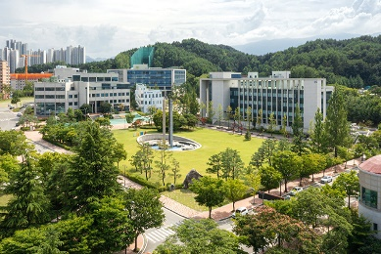

최신물리학 소개
강릉원주대학교
강릉캠퍼스
황지광, 강릉원주대학교 수학물리학부

Slide 2
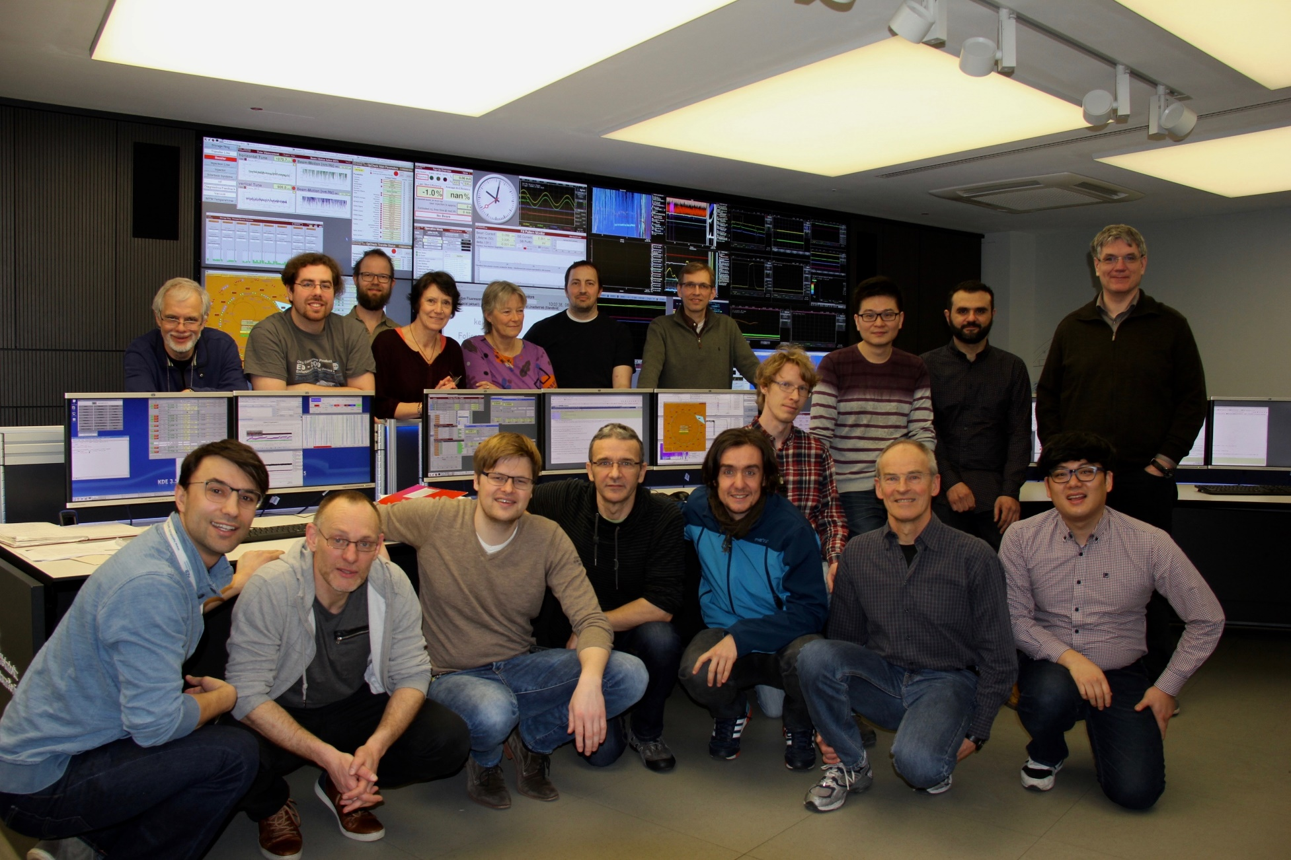



자기소개
2009 B.S. in Department of Physics and Energy science
Energy Science major
2011 M.S. in Accelerator Physics (Beam dynamics)
2014 Ph.D. in Accelerator Physics (Beam dynamics)
2014~2016: heavy-ion therapy accelerator
Post-doc + Senior Scientist
(for beam diagnostics)
2016~2023 : Electron storage ring
Group leader for beam diagnostics

Slide 3
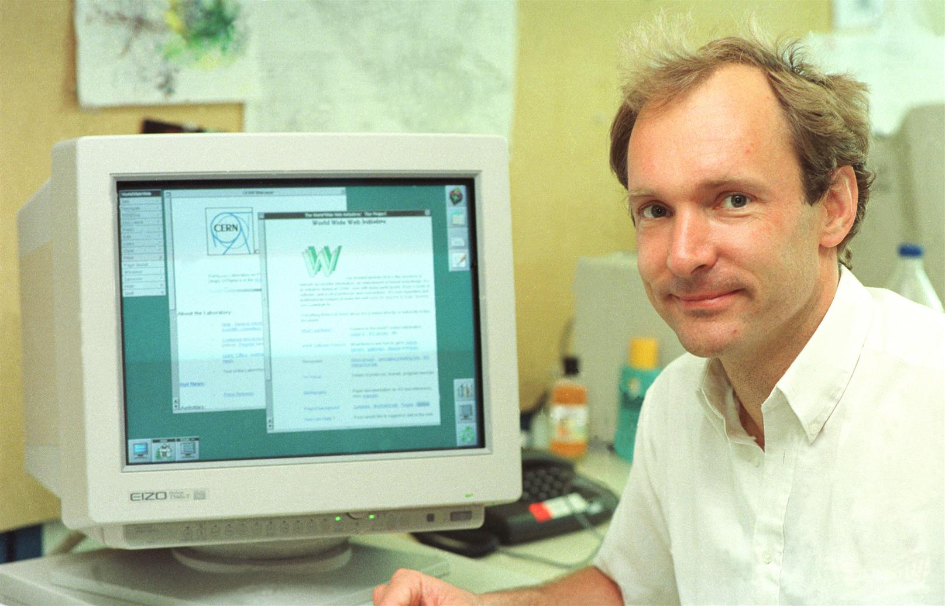
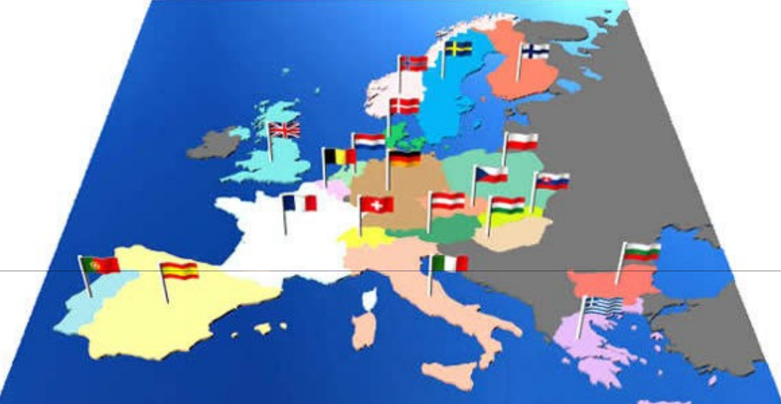
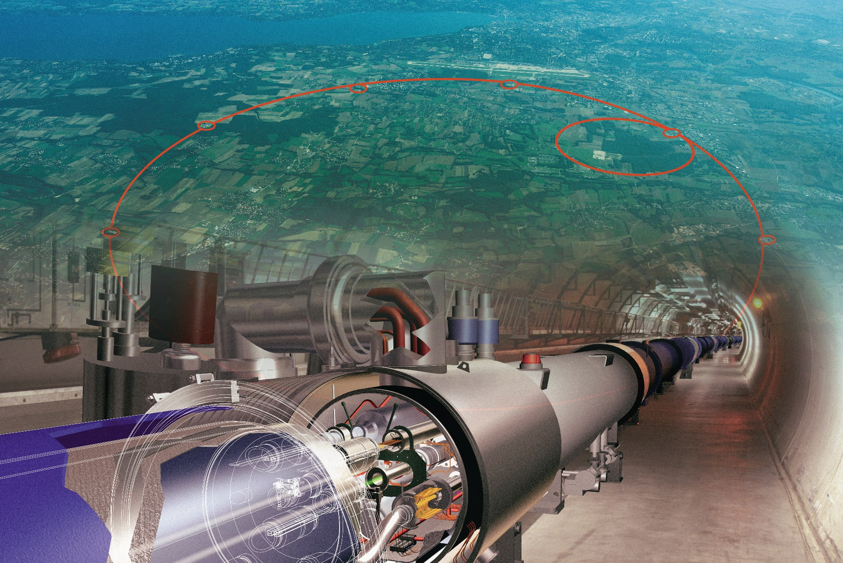
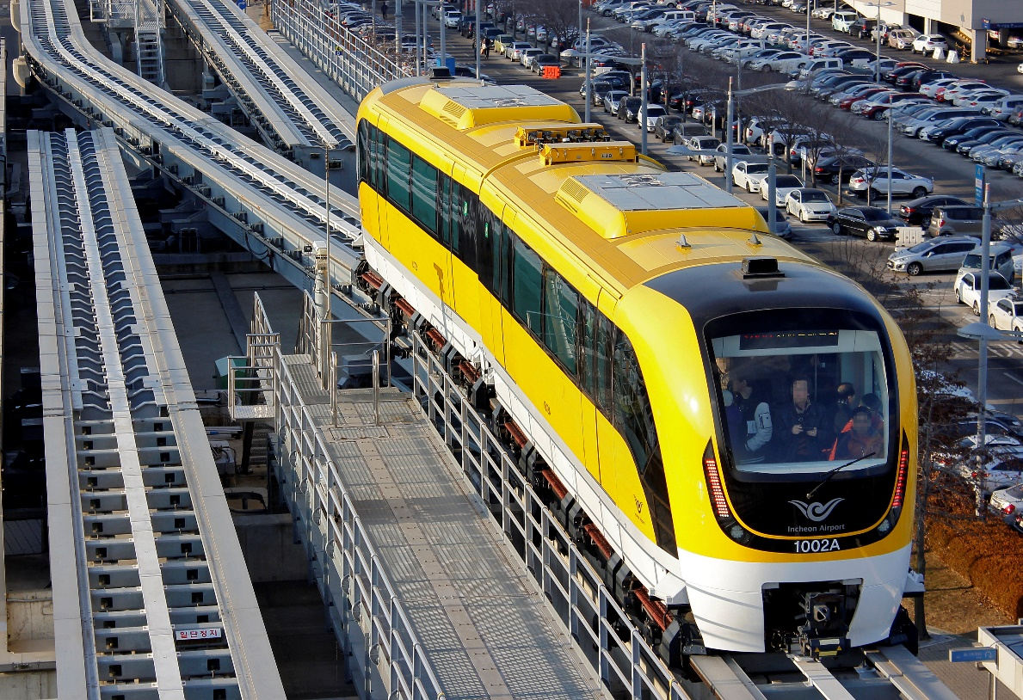
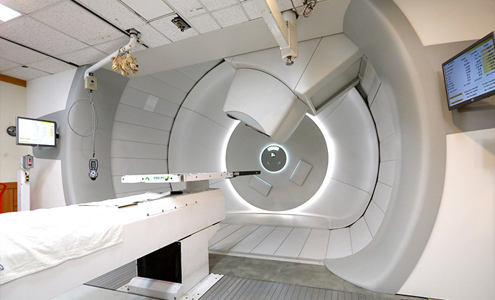
대형과학과 일상의 연결
인터넷의 시작
World Wide Web
건설비용: 약 6.3조원
1년 예산: 약 2조원
자기부상열차
초전도체 연구
의료 (암치료)
양성자치료기

Slide 4
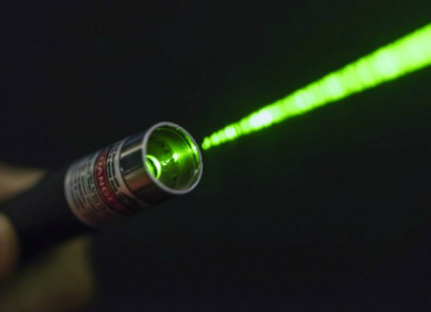
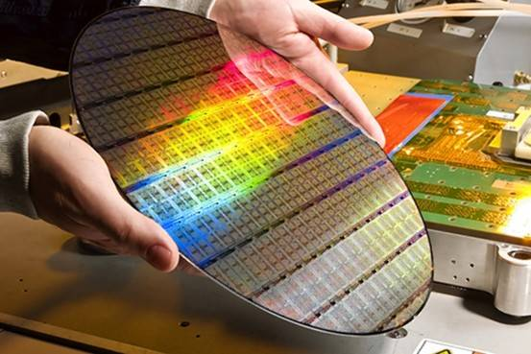
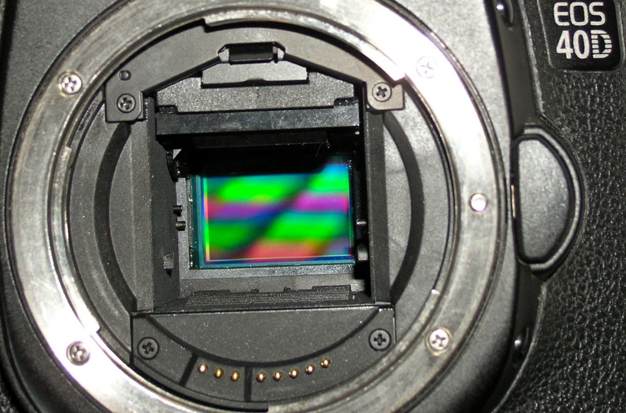
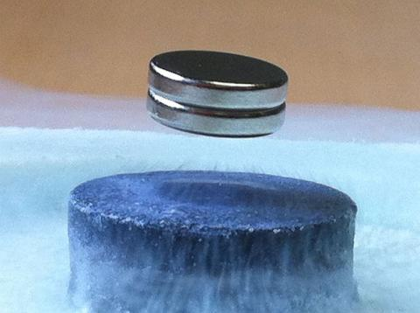
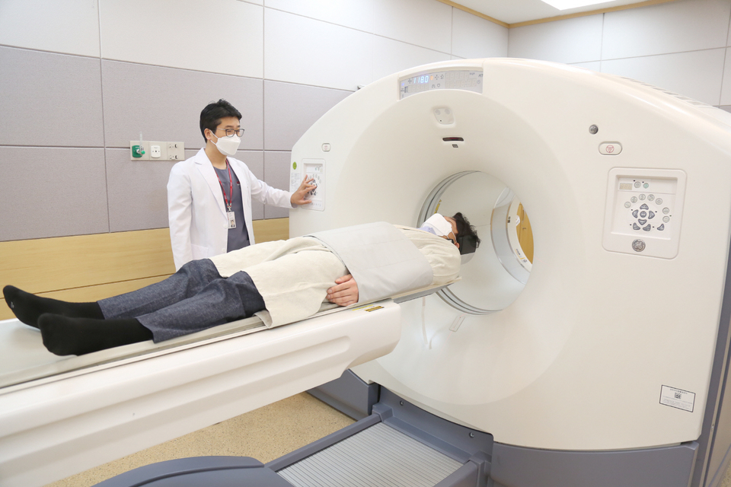
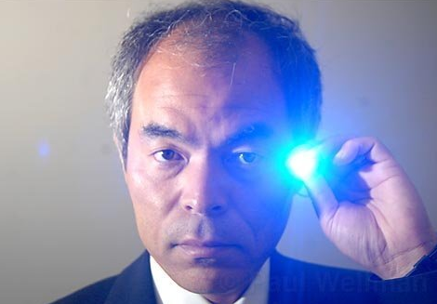
노벨상 속 물리
레이저 (1964)
반도체 (1956/73/2000)
CCD 센서 (2009)
초전도체 (1972/73/87/2003)
X-선 (1901), CT (1979), MRI (2003)
청색 LED (2014)

Slide 5


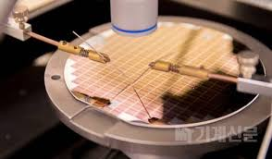



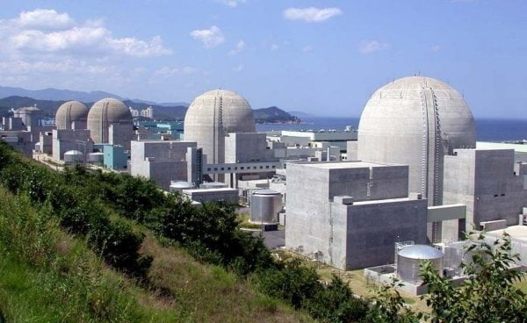
물리학 전공자의 진로
연구원
교원
반도체 기업
IT 회사
의료기기산업
에너지공기업

Slide 6
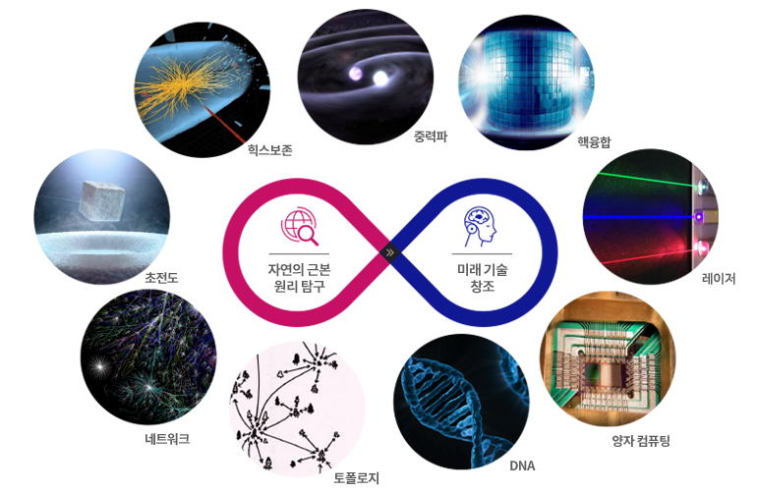
물리학 분야
https://ph.postech.ac.kr/about/about.php

Slide 7
핵 물리학

Slide 8
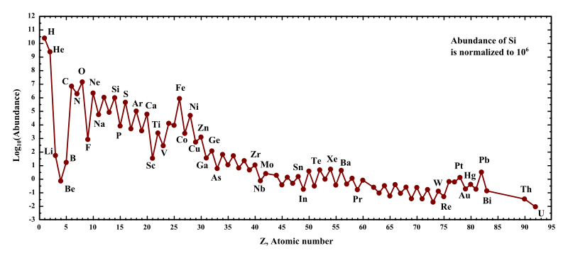
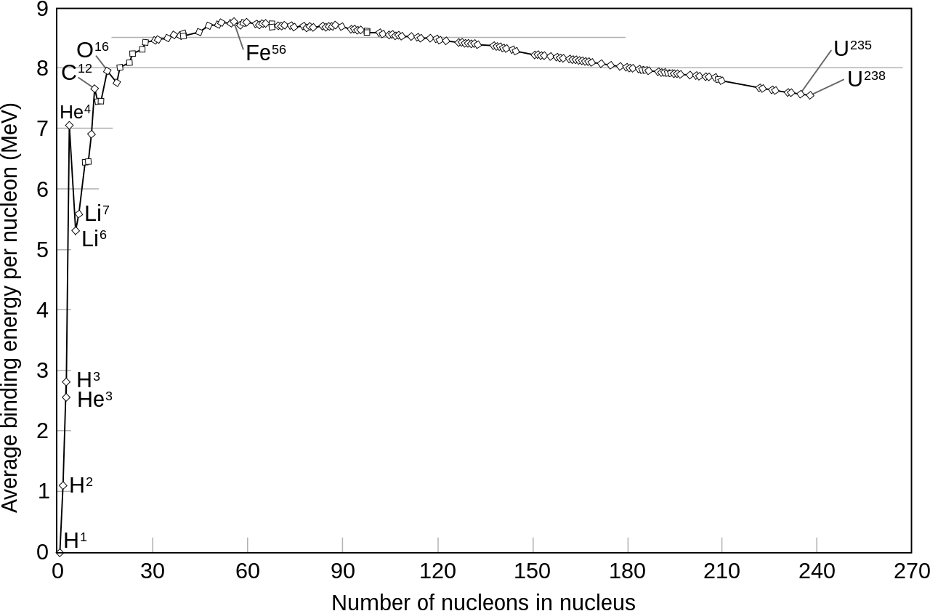
Origin of Heavy nuclei
Abundances of the chemical elements in the Solar System.
Hydrogen and helium are most common, residuals within the paradigm of the Big Bang and the next three elements (Li, Be, B) are rare because they are poorly synthesized in the Big Bang and also in stars.
The three noticeable features in the remaining stellar-produced elements are:
(1) an alternation of abundance of elements according to whether they have even or odd atomic numbers, (2) a general decrease in abundance, as elements become heavier,
(3) within this trend, there is a peak at abundances of iron and nickel.

Slide 9
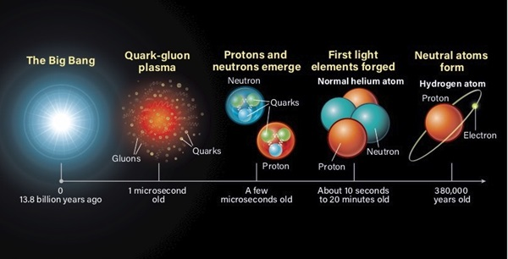
Origin of Heavy nuclei
https://astronomy.com/magazine/news/2021/01/the-beginning-to-the-end-of-the-universe-the-emergence-of-matter

Slide 10
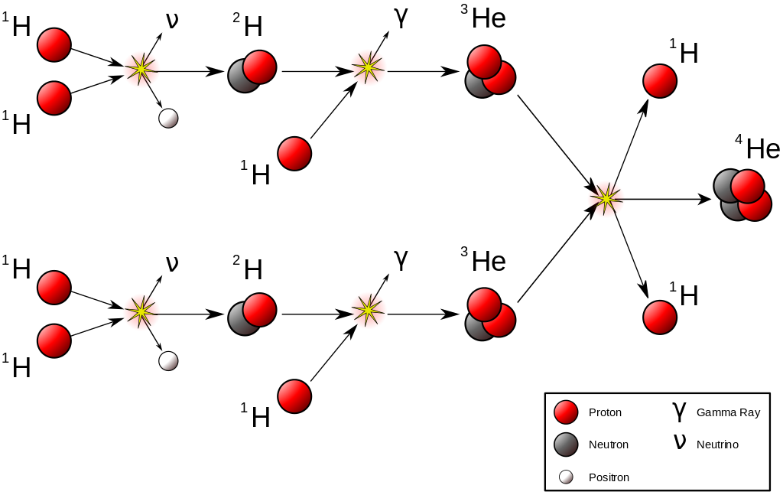
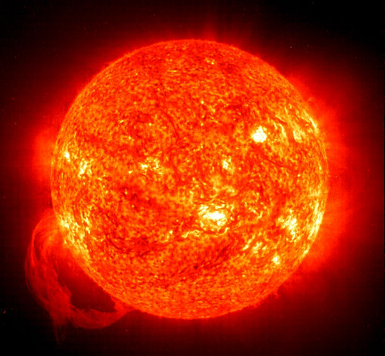
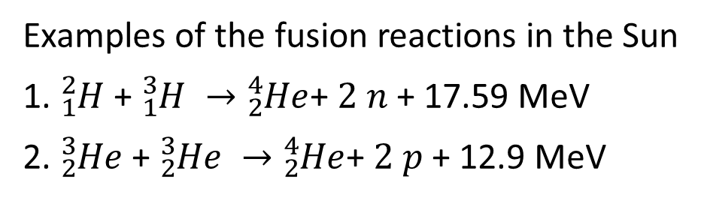
Origin of Heavy nuclei
Examples of the fusion reactions in the Sun
1. ${}_{1}^{2}H$ + ${}_{1}^{3}H →$ ${}_{2}^{4}{He}$+ $2 n$ + 17.59 MeV
2. ${}_{2}^{3}{He}$ + ${}_{2}^{3}{He} →$ ${}_{2}^{4}{He}$+ $2 p$ + 12.9 MeV

Slide 11
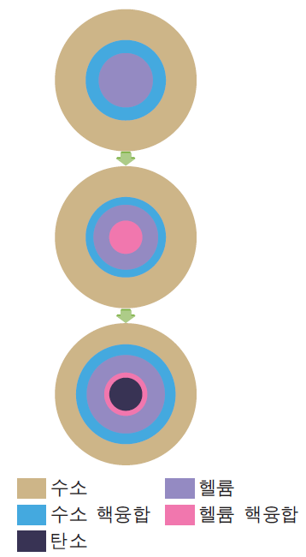
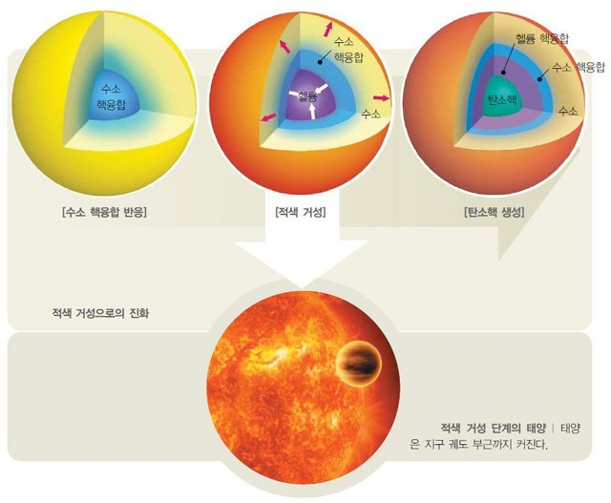
Origin of Heavy nuclei

Slide 12
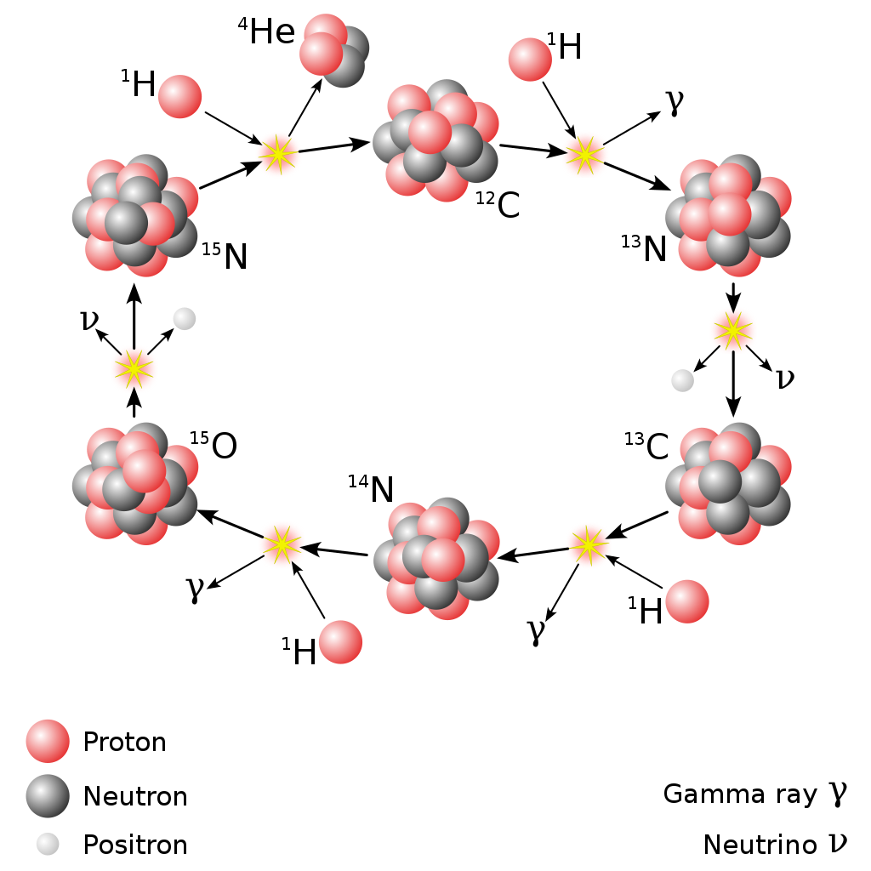
Origin of Heavy nuclei
The CNO cycle dominates in stars heavier than the Sun.

Slide 13
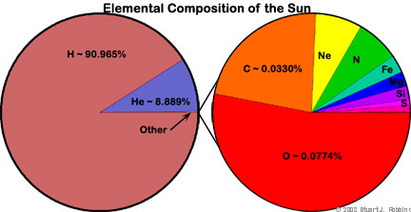
Origin of Heavy nuclei

Slide 14
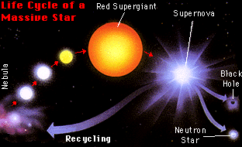
Origin of Heavy nuclei

Slide 15
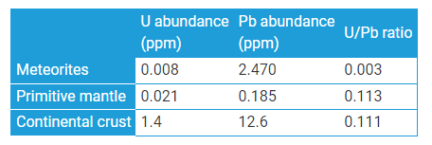
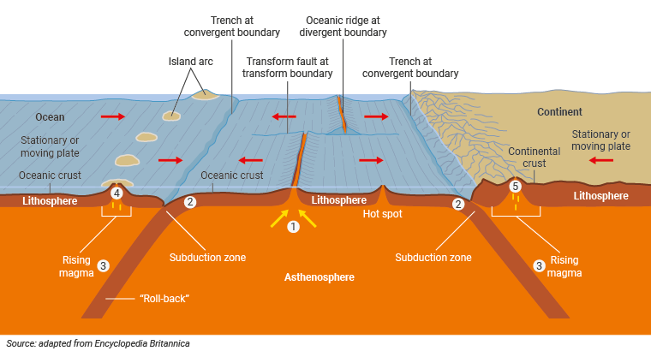
Origin of Heavy nuclei

Slide 16
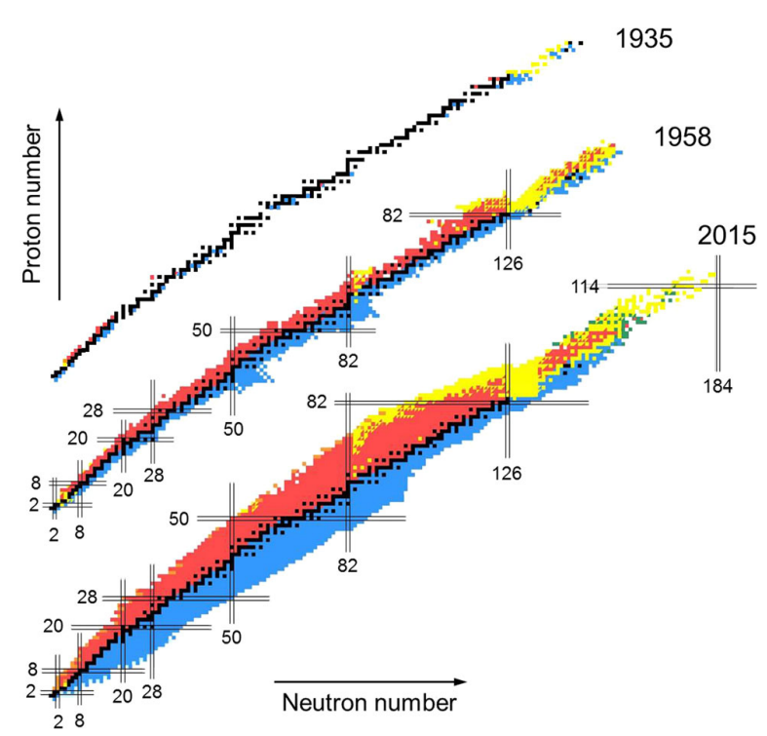
Finding New Nuclei

Slide 17
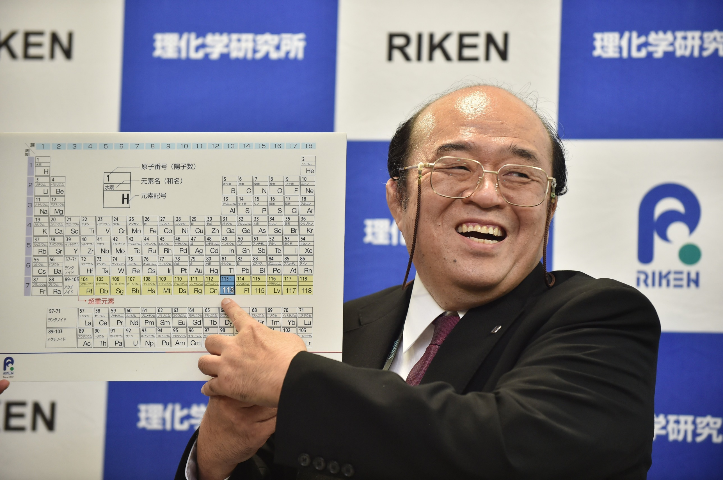
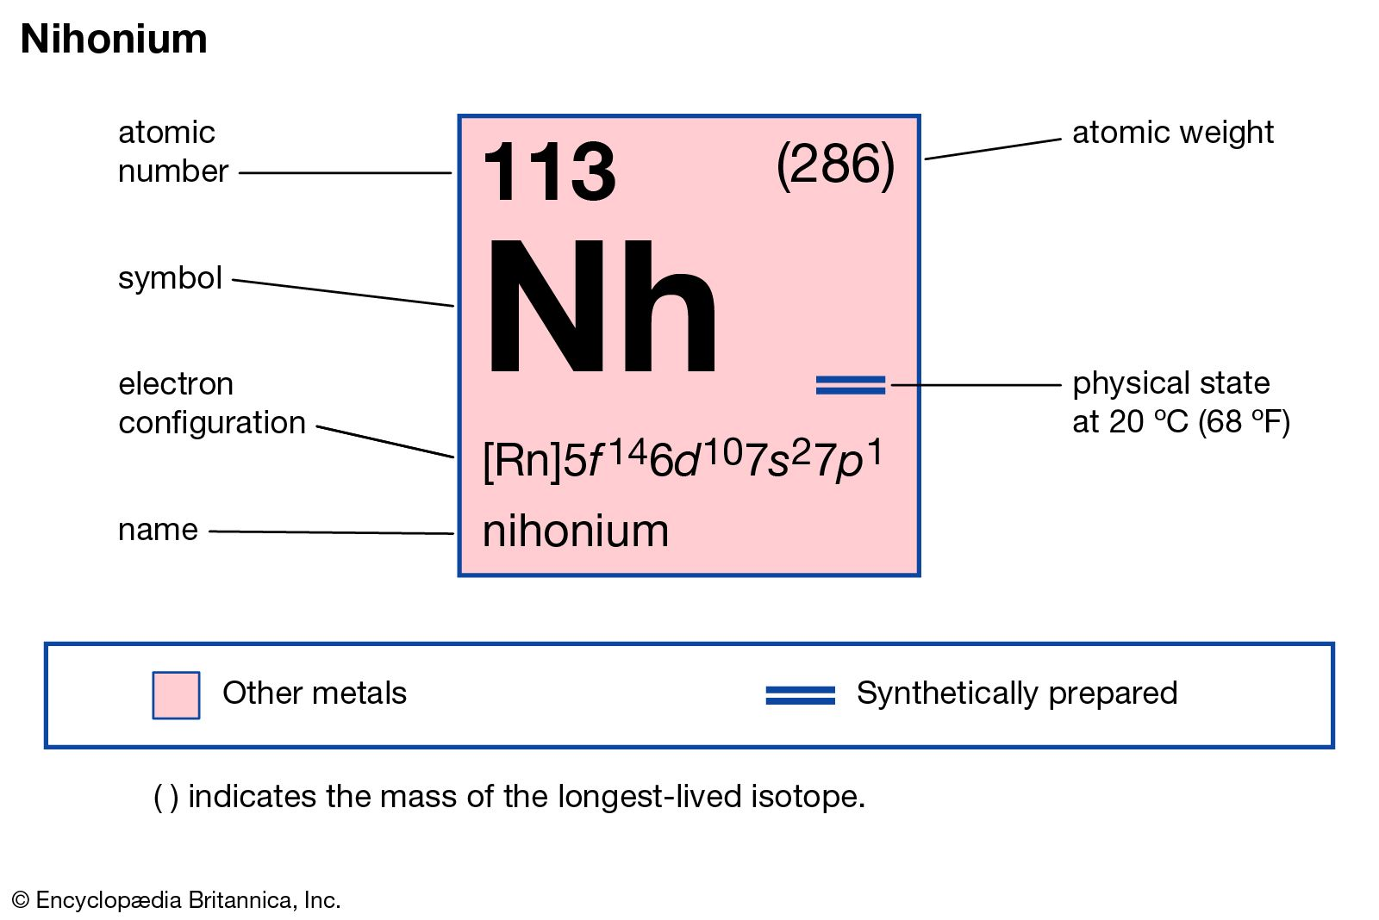
Finding New Nuclei
이화학연구소(RIKEN)는 니호늄을 발견하기 위해 400조 번의 충돌 시도를 거쳐 합성에 성공했으며 이를 위해 투여된 비용은 약 40억엔(약 433억원)이라고 합니다. 신규 원소의 발견이 일상 생활에 바로 도움이 되는 것은 아니나 일본의 이름을 딴 원소를 만드는 것에 의의를 둠.

Slide 18
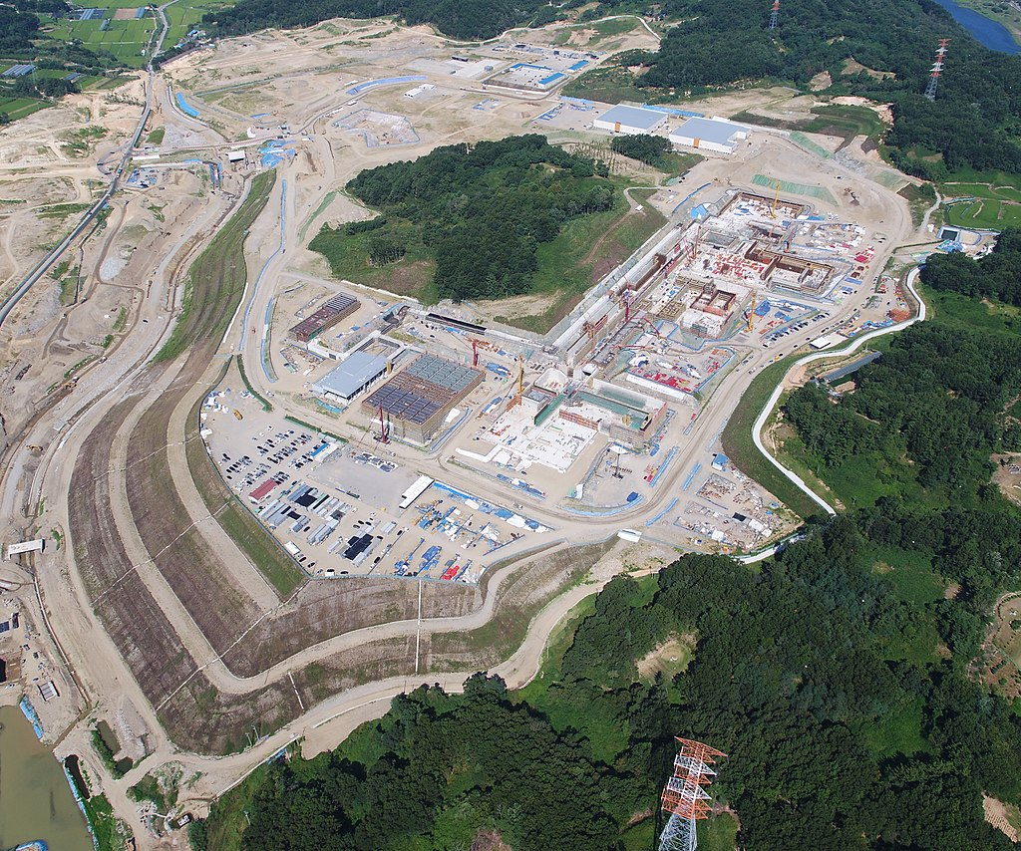
Finding New Nuclei
Heavy ion accelerator in Korea
RAON is a heavy ion particle accelerator that will include both isotope separation on-line (ISOL) and in-flight fragmentation (IF) methods, and aims to be the first to use both.
The superconducting linear accelerator will have a maximum beam power of 400 kW, and projectile fragmentation will be powered by a 200 MeV/u uranium beam in the IF system. The ISOL system will have a H- cyclotron of 70 kW.

Slide 19
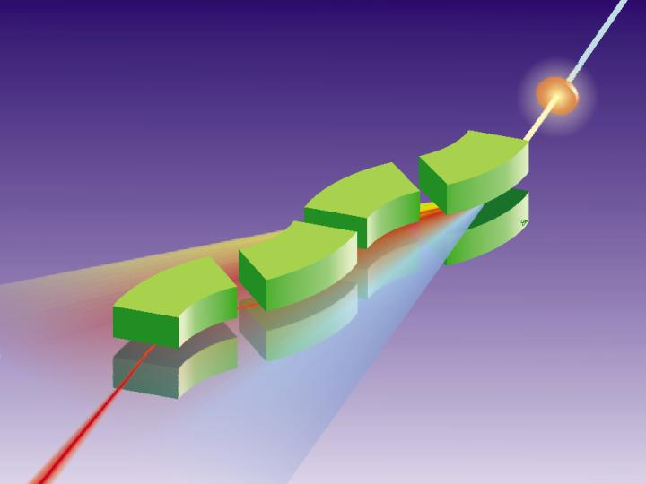
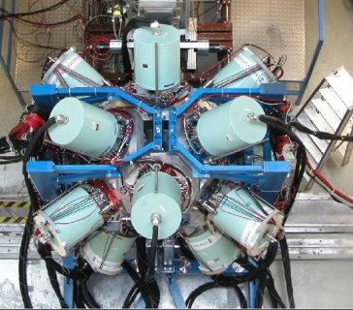

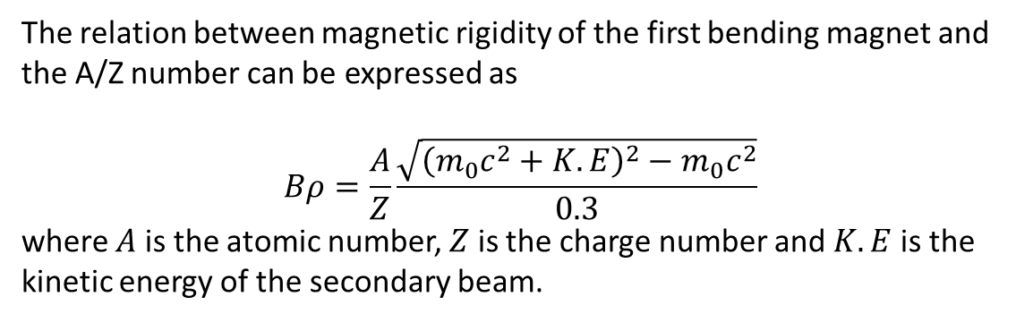
Heavy ion accelerator in Korea
The relation between magnetic rigidity of the first bending magnet and the A/Z number can be expressed as
$$Bρ=\frac{A}{Z}\frac{\sqrt{{\left(m_{0}c^{2}+K.E\right)}^{2}−m_{0}c^{2}}}{0.3}$$
where $A$ is the atomic number, $Z$ is the charge number and $K.E$ is the
kinetic energy of the secondary beam.
fully striped fragments
primary beam
⁸⁶Kr ~700 AMeV
20m
secondary beam
⁷⁸Ni ~ 100 AMeV
production target
⁹Be

Slide 20
Heavy ion accelerator in Korea
Do Gyun Kim, et. al., “Current Status of In-Flight Fragment Separator for RAON ”

Slide 21
고에너지 물리학

Slide 22
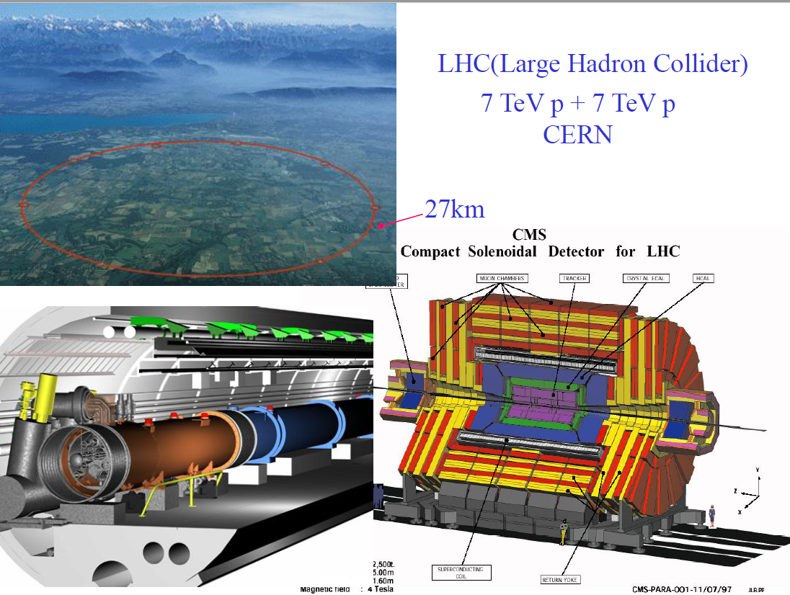

Slide 23
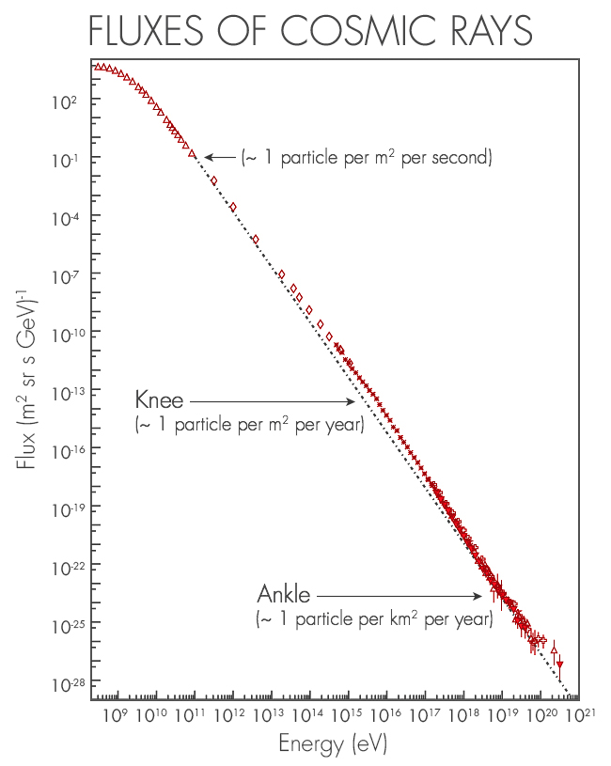
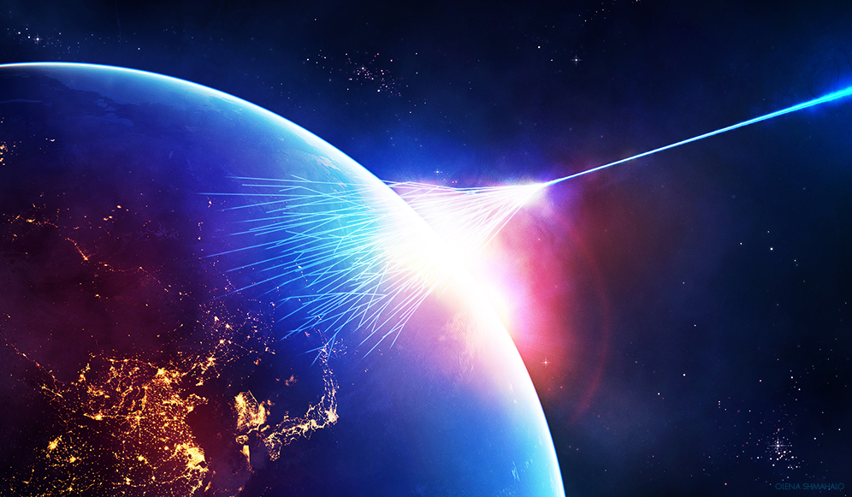
Beyond the accelerator experiments
https://www.quantamagazine.org/the-particle-that-broke-a-cosmic-speed-limit-20150514/

Slide 24
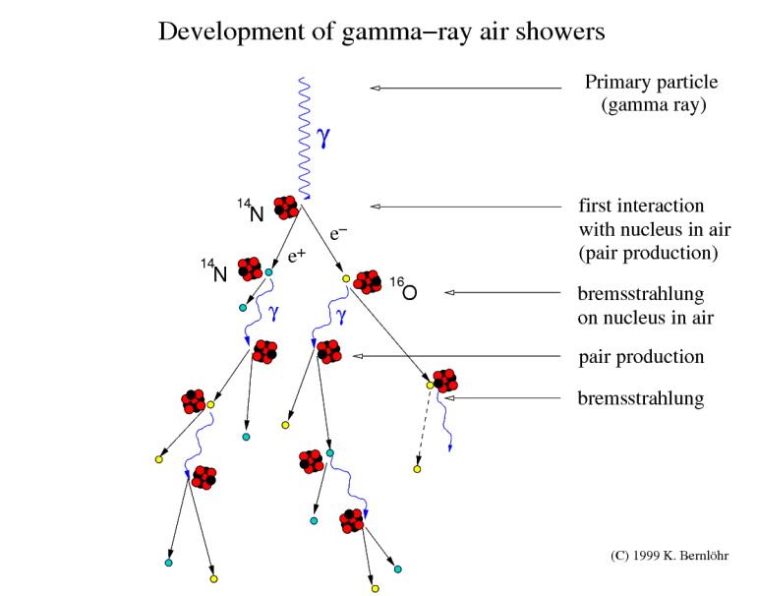
https://www.mpi-hd.mpg.de/hfm/CosmicRay/Showers.html

Slide 25
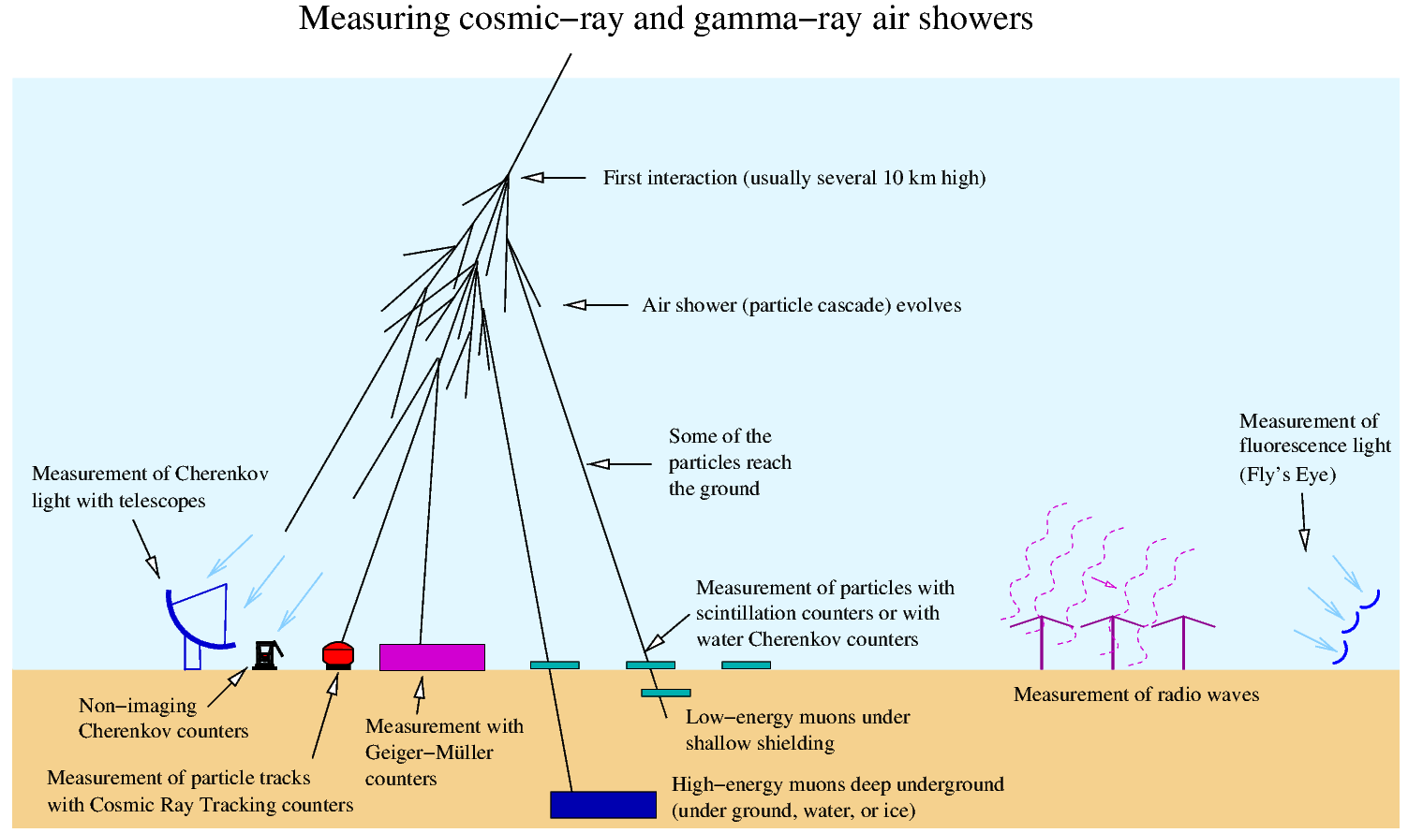
Neutrino

Slide 26
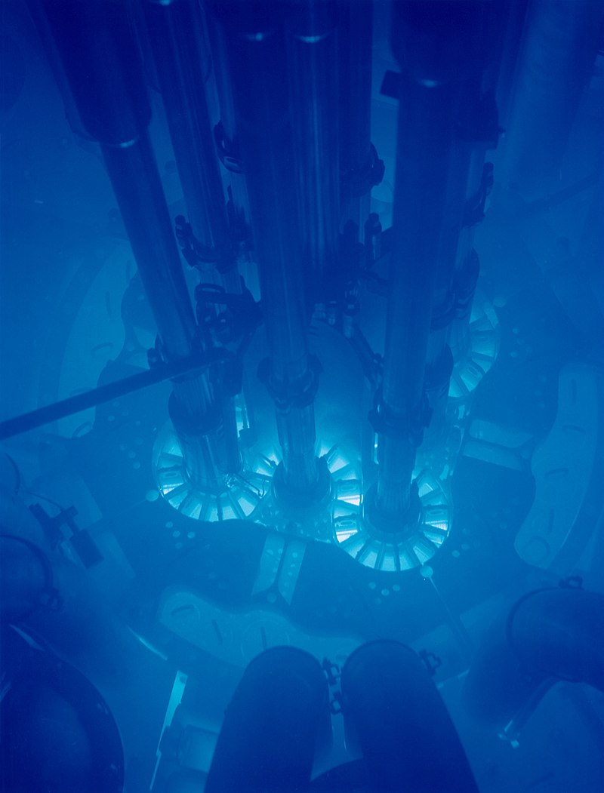
Super-Kamiokande
Cherenkov radiation is emitted when an incoming neutrino creates an electron or muon in the water.

Slide 27
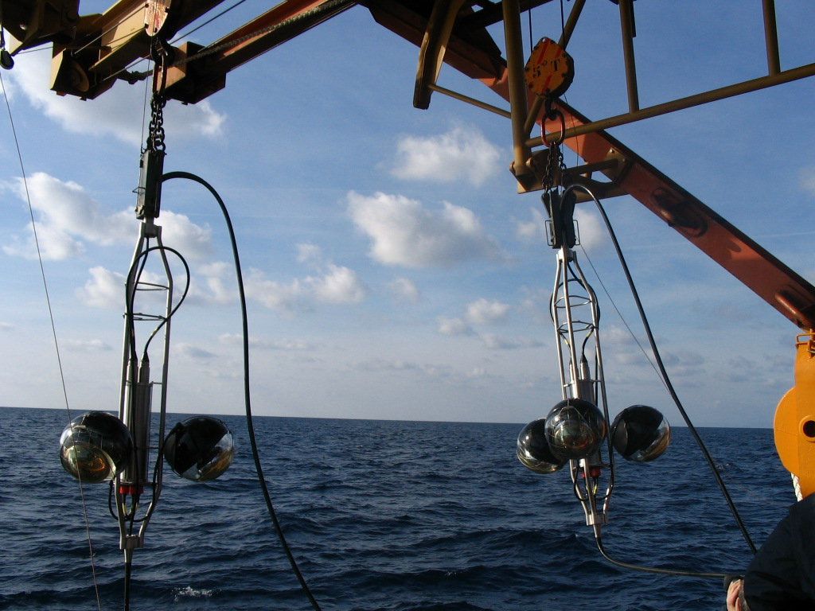
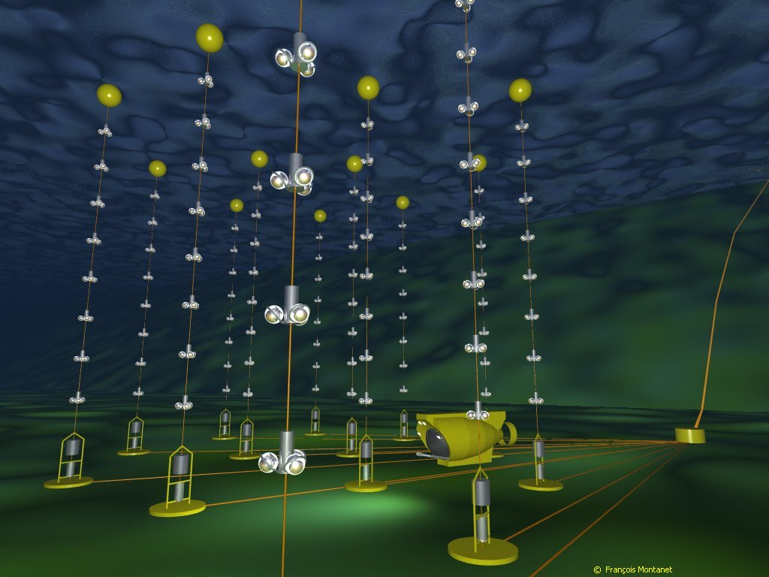
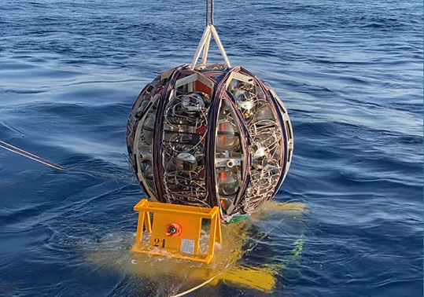
ANTARES project

Slide 28
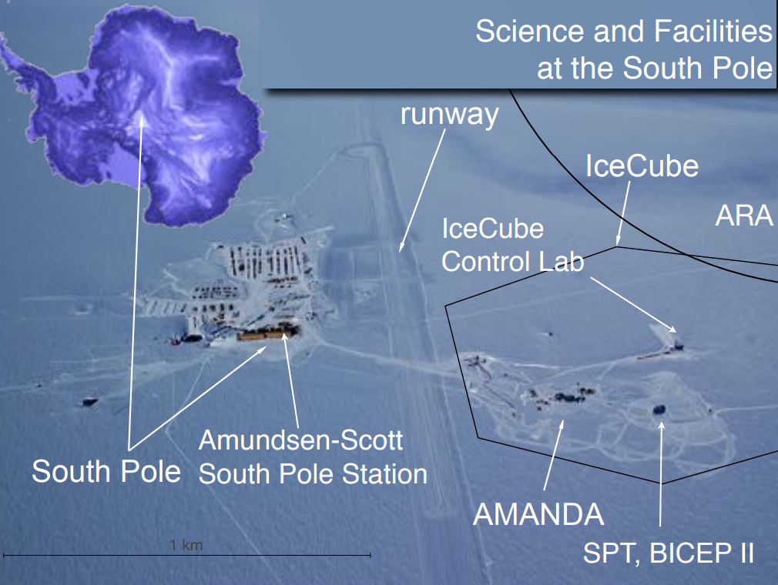
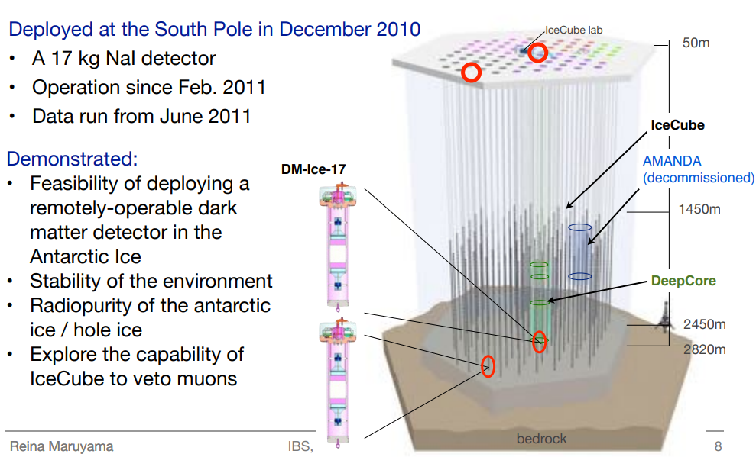
South Pole offers:
• Ultra-clean and ultra-stable environment
• Seasonal variation unambiguously different from dark matter modulation
• IceCube offers muon monitoring and veto as well as experience
• NSF-run South Pole Station for logistical support

Slide 29
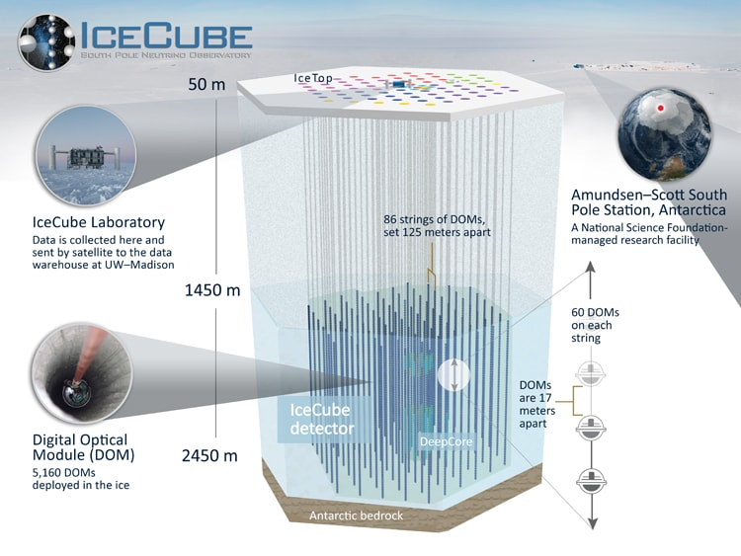

Slide 30
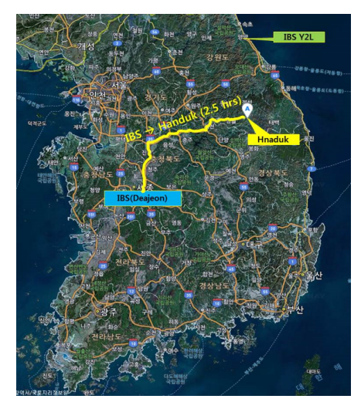
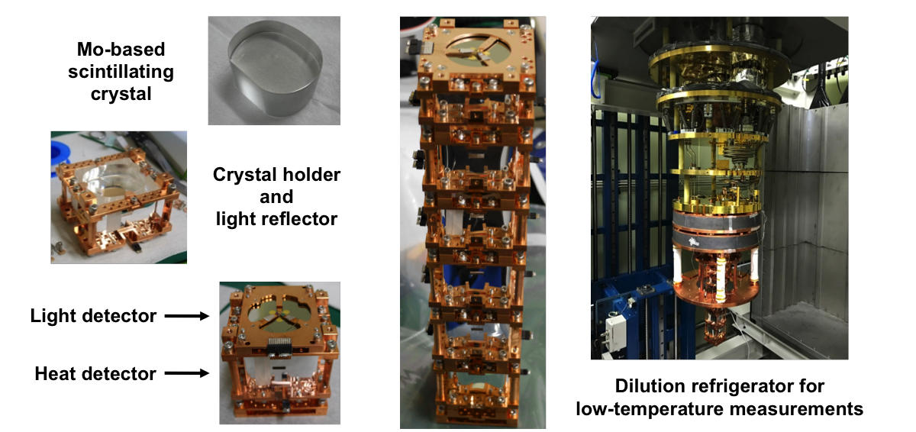

Underground experiments
The Korea Invisible Mass Search (KIMS), is a South Korean experiment, led by Sun Kee Kim, searching for weakly interacting massive particles (WIMPs), one of the candidates for dark matter. The experiments use CsI(Tl) crystals at Yangyang Underground Laboratory (Y2L), in tunnels from a pre-existing underground power plant.
Other research topics include detector development for a neutrinoless double beta decay search in which only two electrons are emerged from the nuclear-beta decays. If this decay were observed, it would be a clear signal that neutrinos have a different mass structure than other elementary particles and would provide a measurement of the absolute neutrino mass scale.

Slide 31

Underground experiments

Slide 32




CREAM experiment
The Cosmic Ray Energetics and Mass (CREAM) experiment was designed and constructed to measure cosmic ray elemental spectra using a series of ultra long duration balloon (ULDB) flights.
proton
Helium

Slide 33



Alpha Magnetic Spectrometer
The Alpha Magnetic Spectrometer (AMS-02) is a particle physics experiment module that is mounted on the International Space Station (ISS).The module is a detector that measures antimatter in cosmic rays; this information is needed to understand the formation of the Universe and search for evidence of dark matter.
By April 15, 2015, AMS-02 had recorded over 60 billion cosmic ray events and 90 billion after five years of operation since its installation in May 2011.

Slide 34



LIGO experiment
~3000 km

Slide 35
가속기 및 플라즈마 물리학

Slide 36








Why accelerator-based light sources?
Spatial resolution for direct imaging
for diffraction technique
(imaging in reciprocal space)
d
θ_{R}
Screen
Sunlight reflected by object enters our eyes
$$λ=2d\sin{θ}$$
Sunlight falls on the object
Rayleigh criterion
$$λ\sim 3d\sin{θ_{R}}$$
The object reflects sunlight in all directions

Slide 37





Storage ring (BESSY II) in HZB

Slide 38


Why accelerator-based light source?
Timescales in the „small“ world:
chemical processes:
$\sim$ns (nano =${10}^{−9}s$)
atomic processes:
$\sim$ps (pico =${10}^{−12}s$)
subatomic structures
/ quantum states:
$\sim$as (atto =${10}^{−15}s$)

Slide 39


Optimization vs Machine learning
Animation from Wikipedia: https://en.wikipedia.org/wiki/Particle_swarm_optimization
Cons: Golf game (Hole for Par 10)
Velocity vectors are updated by:
$$V_{ij}^{t+1}=ωV_{ij}^{t}+c_{1}r_{1}^{t}\left({pbest}_{ij}−X_{ij}^{t}\right) \\ +c_{2}r_{2}^{t}\left({gbest}_{ij}−X_{ij}^{t}\right)$$
with position vectors of
$$X_{ij}^{t+1}=X_{ij}^{t}+V_{ij}^{t+1}$$
Human
Algorithm

Slide 40


핵융합 KSTAR

Slide 41



핵융합 KSTAR

Slide 42
고체 물리학

Slide 43

Condensed matter

Slide 44

Solar cell

Slide 45



Superconductivity
https://youtu.be/zGPb04wg_5o

Slide 46


High-Tc superconductor

Slide 47
Metallic water
Under normal conditions, pure water is an almost perfect insulator. Water only develops metallic properties under extreme pressure, such as exists deep inside of large planets.
H₂O molecules are loosely linked to one another via hydrogen bonds. The valence electrons remain bound and are not mobile. To create a conduction band with freely moving electrons, water would have to be pressurized to such an extent that the orbitals of the outer electrons overlap.
The chemistry between alkali metals and water is known to be explosive. Sodium or other alkali metals immediately start to burn in water. They did not throw a piece of alkali metal into water, but they did it the other way round: they put a tiny bit of water on a drop of alkali metal, a sodium-potassium (Na-K) alloy, which is liquid at room temperature.

Slide 48



Phase transition
Studying ultrafast phase transitions by fs Resonant X-ray Diffraction
M.-F. Lin et al., Nat. Commun. 8, 1745 (2017).
Courtesy of BESSY II fs-XRD beamline
The combination of resonant x-ray diffraction with ultra-short light pulses allows studying phase transitions of correlated materials in an ultrafast fashion.

Slide 49


물리학과 전공과목

Slide 50


Slide 51


Optimization vs Machine learning
Reinforcement learning
Courtesy of L. Vera Ramirez, HZB, 2nd ML Tutorial
16

Slide 52


Synchrotron Radiation detectors
BESSY II VIS beamline

Slide 53


Synchrotron Radiation
Heinz Graafsma, “Introduction to Synchrotron Radiation Detectors” (2012)

Slide 54





Light source basics
Diffraction-limited light source
Emittance of photon beam with Gaussian dist. :
$ε_{γ}=$1.23 nm (@1 keV)/4π ~ 97 pm-rad
Coherent Synchrotron Radiation
$$ε_{γ}(λ)=σ_{γ}σ_{γ}^{′}=\frac{λ}{4π}$$
φ
waist
The radiation power is proportional to the square of the radiation field and summing over all electrons we get
$$P\left(ω\right)∝\sum_{k,j}^{N_{e}}{E_{k}}{E_{j}}^{∗}∝\sum_{k,j}^{N_{e}}{e^{i\left(ωt+φ_{k}\right)}}e^{−i\left(ωt+φ_{j}\right)}=\sum_{k,j}^{N_{e}}{e^{i\left(φ_{k}−φ_{j}\right)}}=N_{e}+\sum_{k≠j}^{N_{e}}{e^{i\left(φ_{k}−φ_{j}\right)}} =N_{e}+N_{e}(N_{e}−1) \int_{−∞}^{∞}{dz {f(z)e}^{i\frac{2π}{λ}z}}\int_{−∞}^{∞}{dw {f\left(w\right)e}^{i\frac{2π}{λ}w}}$$
where $f(x)$ is the distribution function.
Convolution by electron beam:
$$ε_{tx}\left(λ\right)=ε_{x,e−}⨂{ ε}_{γ}(λ)$$
x’
x’
x
x
10

Slide 55


Synchrotron Radiation detectors
Spatial resolution for direct imaging
d
θ_{R}
Screen
Rayleigh criterion: $λ\sim 3d\sin{θ_{R}}$

Slide 56





Synchrotron Radiation detectors
BESSY II Pinhole array for emittance measurements
Resolution of a pinhole camera :
$$σ_{res}=\sqrt{σ_{blur}^{2}+σ_{diff}^{2}}$$
$$σ_{blur}=\frac{a}{\sqrt{2 π}}\frac{d_{1}+d_{2}}{d_{1}}$$
$$σ_{diff}=\frac{\sqrt{12}}{4π}\frac{λd_{2}}{a}$$
20 keV (1.2T) →50 keV (3T)
Res.: 10 → 5 μm rms
10 keV X-ray
Pros: Compact and simple system
High-resolution ( ~ 10 μm)
Cons: Not suitable for bunch-resolved monitor
X-ray shielding (bad mobility)
Courtesy A. Loulergue.
PRELIMINAR DESIGN

Slide 57





Synchrotron Radiation detectors
BESSY II
An interference pattern produced by double slit with a “point-like” source is given by
$$I(x)=I_{0}{{sinc}^{2}\left(\frac{πa}{λR}x\right)cos}^{2}\left(\frac{πd}{λR} x+φ\right) ,$$
where $λ$ is wavelength, $R$ is distance between slit and screen, $d$ is slit separation, $a$ is slit width.
$$σ=40 μm$$
For a Gaussian distributed source, the interference pattern is
$$I(x)=I_{0}{sinc}^{2}\left(\frac{πa}{λR}x\right)(1+\left|γ\right|cos\left(\frac{2πd}{λR} x+φ_{0}\right) .$$

Slide 58




Synchrotron Radiation detectors
Courtesy of G. Hahn, PLS-II
Pohang Light Source-II

Slide 59

https://www.hufs.ac.kr/user/indexSub.action?codyMenuSeq=7995538&siteId=naturalscience&menuType=T&uId=2&sortChar=A&linkUrl=2_5.html&mainFrame=right

